Slide 1
2022 NEW YORK PRE-DEPARTURE SEMINAR COMMUNITY INVOLVEMENT: HOW TO IMMERSE YOURSELF WHILE ON JET
By Ryan Hata (ALT, Tottori-ken, 2014-2017)
Contact email: president@jetaany.org

Slide 2
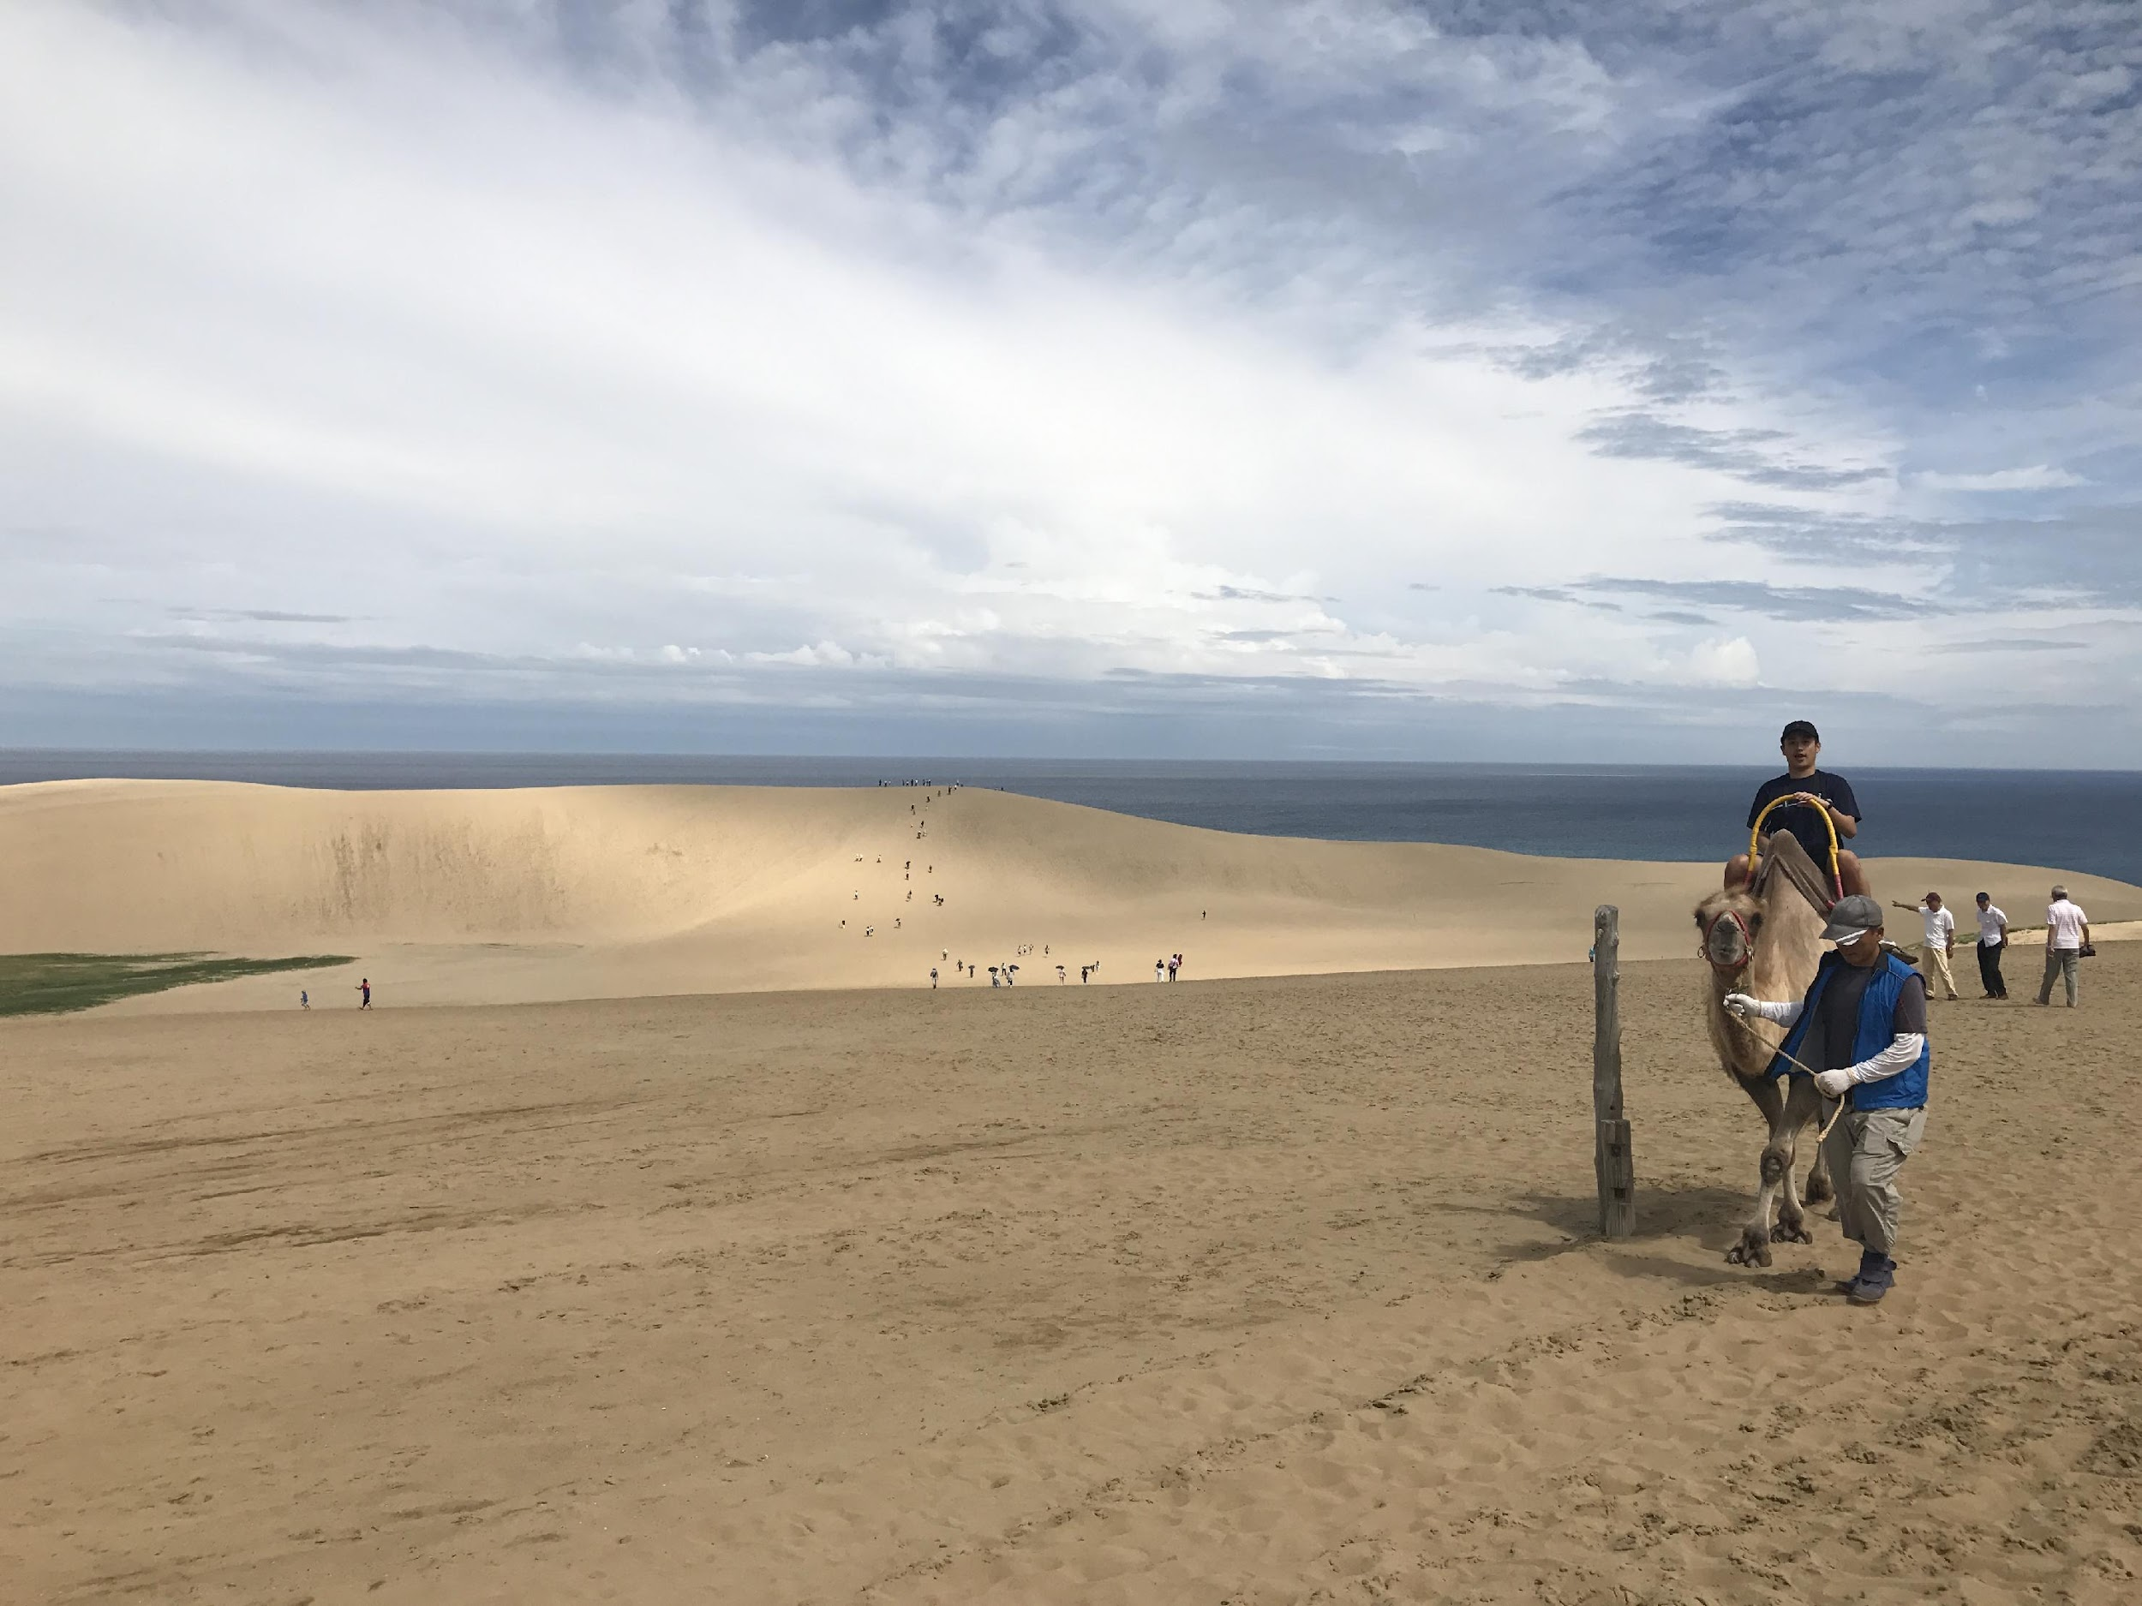
INTRODUCTION
Give Yourself Time and Space
Be Proactive!
Rock your Comfort Zone
Notes:
1. Heading to Japan, getting accustomed to a new language, city, culture etc. is really scary: Give yourself time and space
2. Don’t be afraid to ask questions yourself, seek and find, explore your new settings on your own
3. Be open-minded

Slide 3
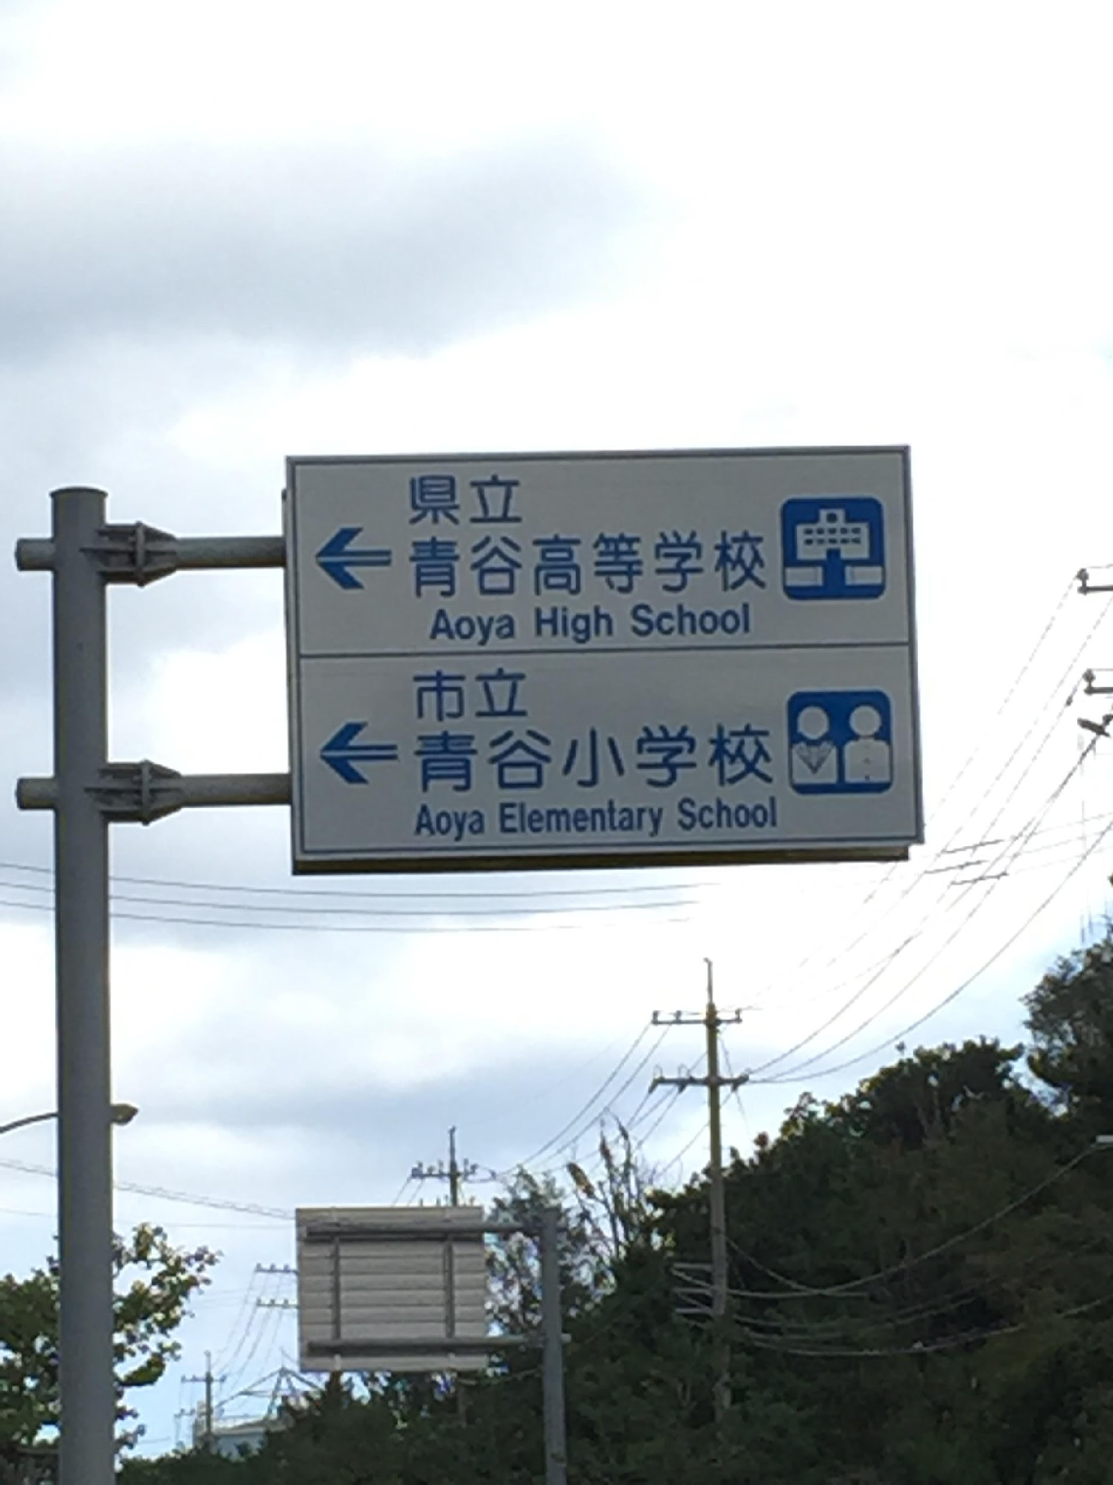
WORK LIFE BALANCE
Most of you will be ALTs and your main tasks will be associated at your schools
Down Time
After School Clubs
Enkais
Notes:
Make sure you focus on your work duties
However, you may have time to do research at your desk or study
If you’re lucky, you’ll be able to join an after school club
Join your enkais or work parties to meet with other teachers. Here, you can express your interests and they could be a valuable resource to connect or put you in the right direction

Slide 4
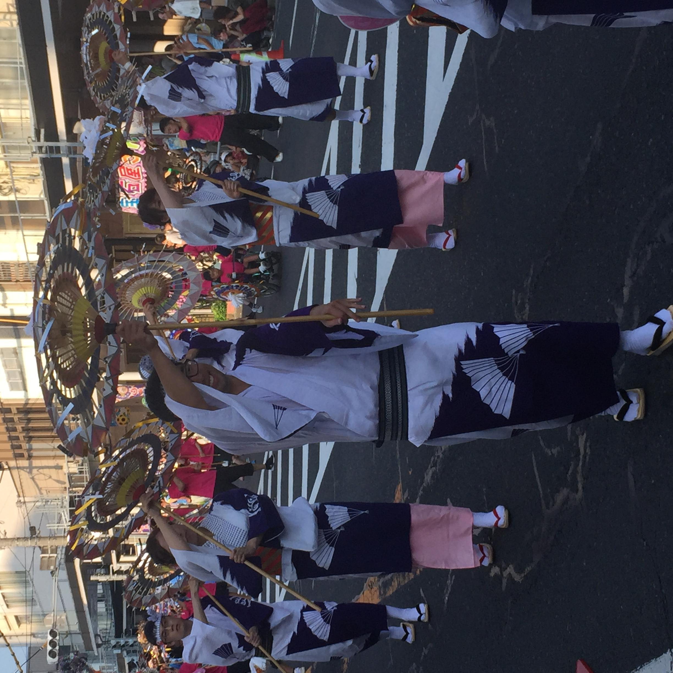
LOCAL COMMUNITY
Language Exchange
Community or Civic Centers
Local Festivals
Volunteer Opportunities
Notes:
Language exchange—meet with people who want to learn English and can teach you Japanese
There might be opportunities to get involved with your local community or civic center—in Tottori, there was an International Festival
Local Festival—In Tottori, there’s the Shan Shan Festival to bring rain to our crops
Volunteer opportunities—I taught hula to my PA’s children’s Saturday school, volunteered at a local Japanese orphanage

Slide 5
ASSOCIATION FOR JETS (AJET)
Prefectural (From JETAA Vice Chair, Laurence Inniss)
National
Special Interest Groups
Notes:
Prefectural—plan events with your fellow JETs: went hiking, karaoke, etc. Shout out to JETAA T&T country rep, Laurence Inniss for curating this list. [https://drive.google.com/file/d/1eySa4rgpAGjpIrWh_puYO_ps5txpVWTT/view]
National AJET—for advancement of the JET Program. I got to make a speech at the 30th Anniversary of the JET Program and meet with then Crown Prince Naruhito and Crown Princess Masako. [https://ajet.net/]
Special Interest Groups—[https://ajet.net/jet-community/special-interest-nationality-language-groups/]

Slide 6
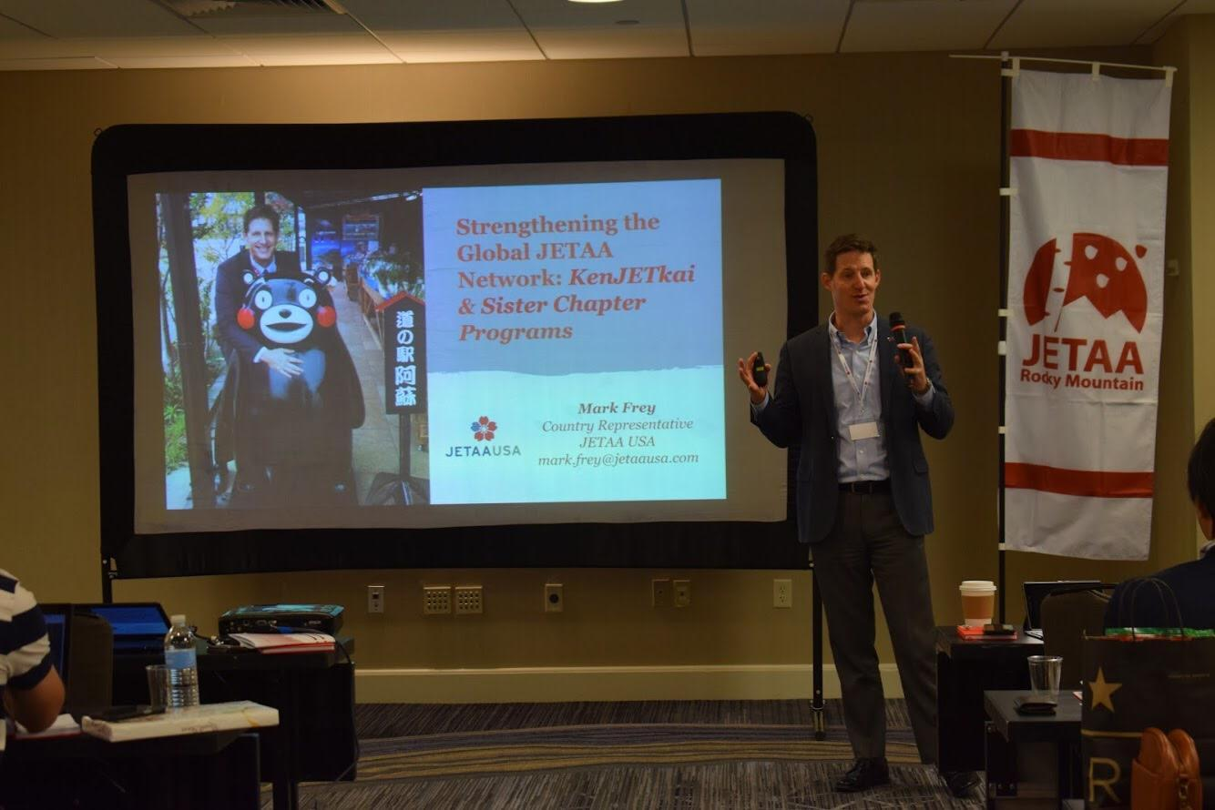
KenJETkai
Born from Mark Frey’s idea as a collection of prefecture-centric resources for JETs
Its aim is to help promote tourism and economic opportunities between the prefectures that we have had the privilege of living in, and our home countries
Notes:
To strengthen the bonds among JETs, JET alumni and their prefectures.
To increase cohesion between current JETs and alumni.
In doing so, achieve the following:
Better After-JET support system
Increased opportunities and resources for JETs and JET alumni
Provide a gathering place for current and former JETs and people in their prefecture, where they can exchange information and celebrate what they love about their home in Japan.
Connect current JETs to their sempai as a resource for mentoring, support, and assistance in transitioning into their lives after JET.
Connect alumni with their kohai JETs and other people in their prefecture, to maintain their ties and keep up on what’s going on there.
Connect prefectures to “their JETs” and the larger alumni network, to help JETs preserve the bonds they have built with their furusato and give the prefecture access to this “expat” community that can assist with their various efforts to promote and develop their areas.

Slide 7
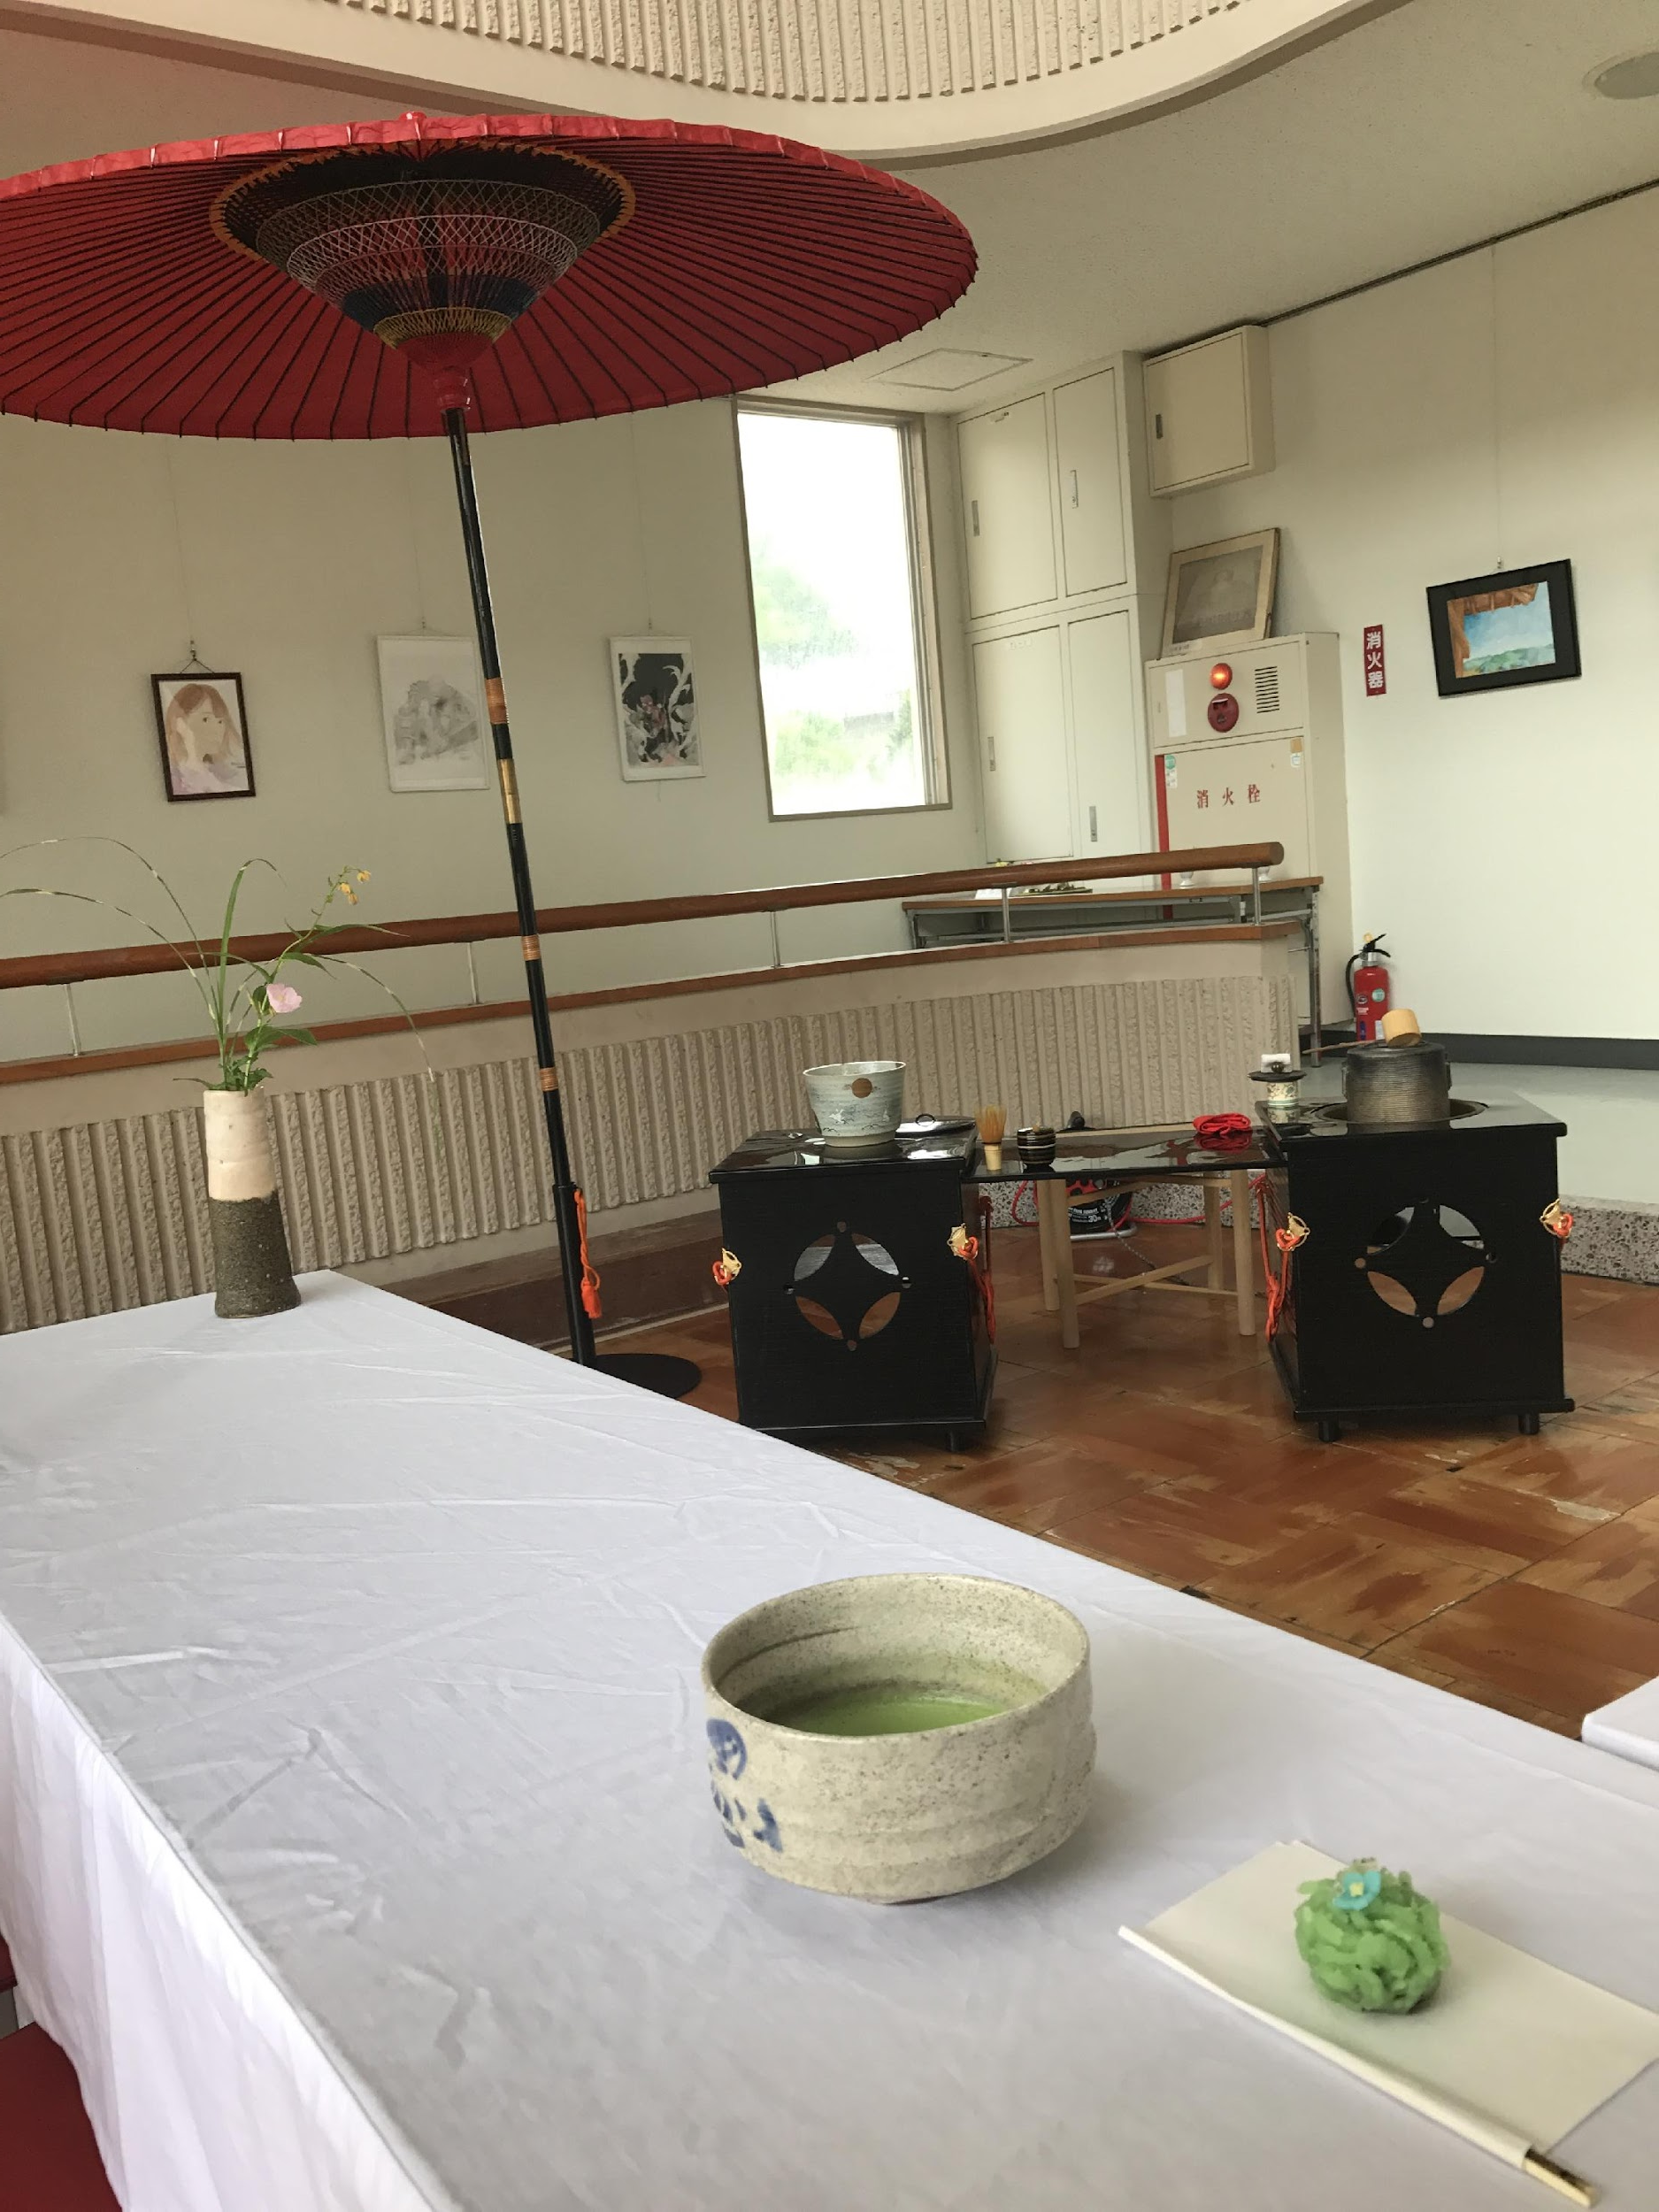
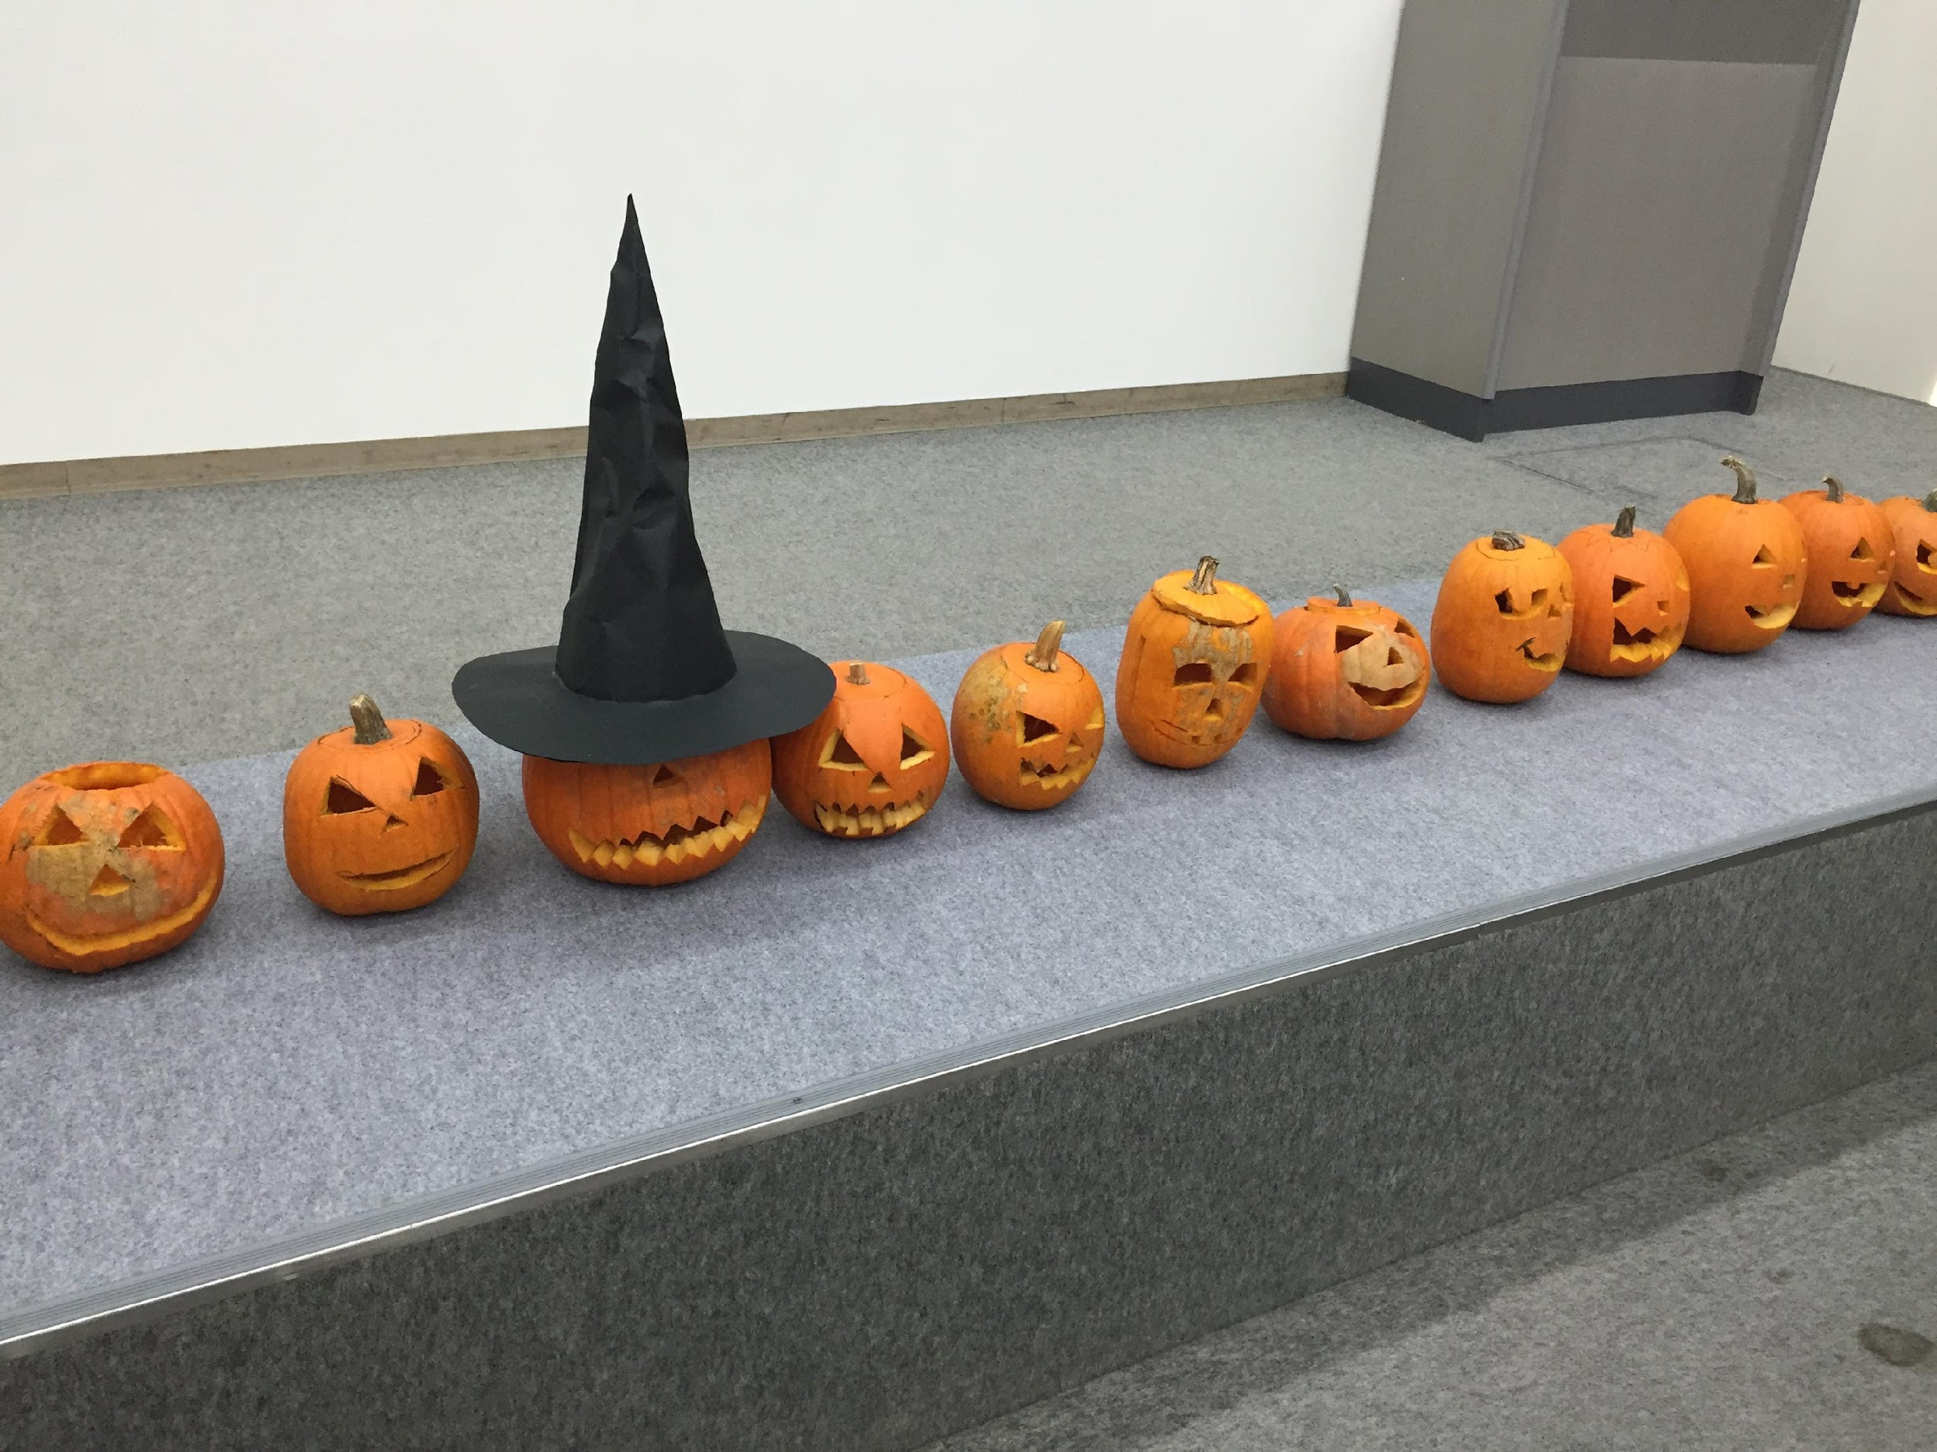
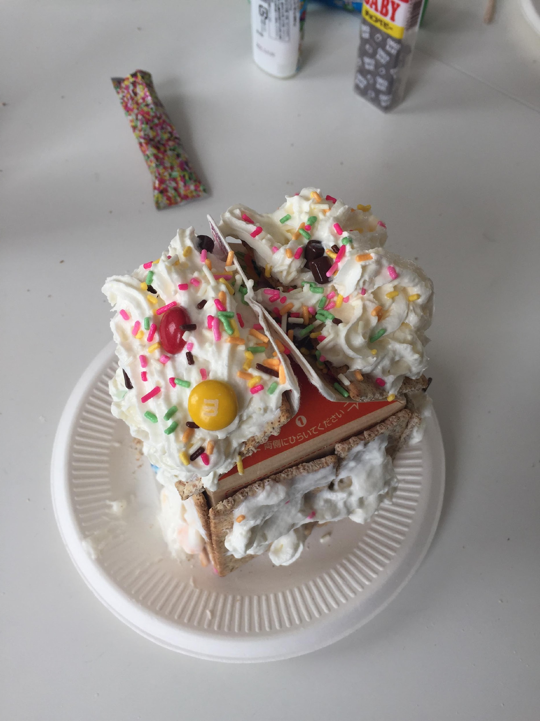
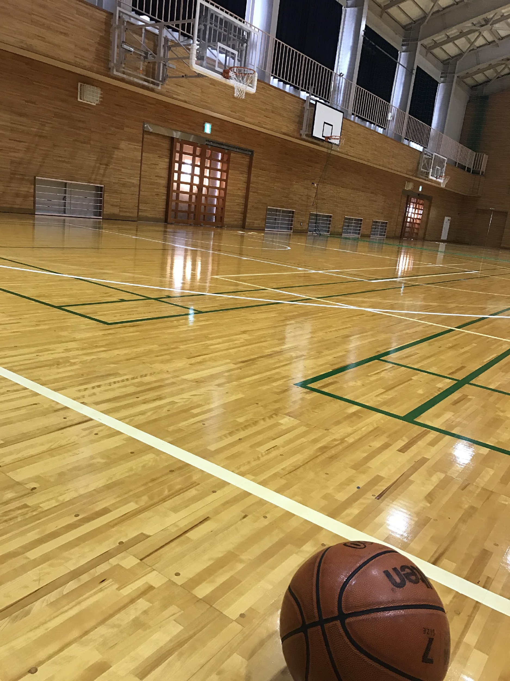
ULTIMATELY…BE YOURSELF!
Make sure you find some hobbies you’re passionate about or interested in
Seek out help from fellow JETs, colleagues, your BOE, etc.

