Slide 1
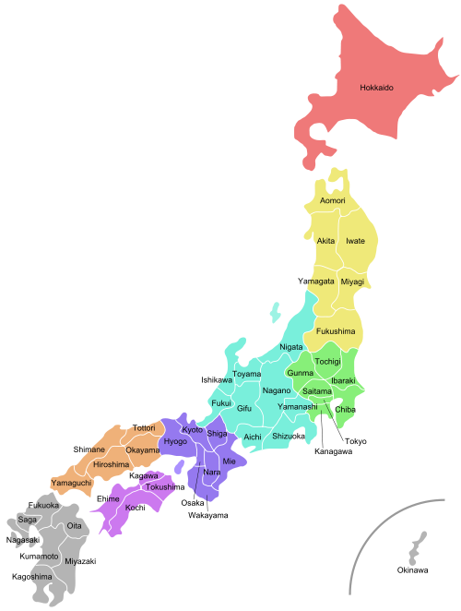
What to Expect
A guide to your first few weeks on JET
By Pat Penny

Slide 2
Before Leaving for Japan
Make sure you have enough money to last you until your first payday.
There will be some upfront expenses (apartment, cell phone, travel, “networking” with other JETs)
Have copies of your passport signature and visa pages, as well as any other documents you think you may need (tax forms, Rx notice, etc).
Bring food you can’t live without if you expect to be very rural. Bring cosmetic/toiletry brands you like as Japanese brands can be a let down. Don’t overdo it, Costco and Amazon are still around if you need a taste of home or miss your brands.

Slide 3
Before Leaving for Japan
Talk to your predecessor about
What your schools are like – how many teachers and students, teaching schedule, team teaching, etc…
What your living situation is – are you taking over their apartment, are they selling/giving you furniture, rent/utility costs, etc…
What the area is like – supermarkets, conbini, izakaya, tourist attractions…
Study Japanese (JLPT, Memrise, Tutor, Classes, CLAIR)
Get an IDL
Join your Prefecture’s JET/ ALT facebook page
Create your self-introduction lesson!

Slide 4
Arrival and Tokyo Orientation
Upon arrival you will receive your residence card, keep this with you at all times.
Meet JETs from other prefectures.
Making friends with other JETs can open up future travel opportunities.
Learn teaching skills / life skills for having a successful experience in Japan.
Explore Tokyo!

Slide 5
Your First Week in Japan
Your supervisor or Senpai JETs will usually have a schedule for your first day or two, this includes:
opening a bank account (and learning that ATMs aren’t 24/7)
Getting an Inkan/Hanko (Personal stamp)
getting an apartment (you may be doing a homestay if you aren’t moving into your predecessors apartment right away)
phone/internet
turning on utilities
using appliances (make sure you know how to use your appliances…)
paying bills
Hit up the Daiso/hyaku-en stores and Hard-off/ second-hand stores first for your apartment needs.

Slide 6
Your First Week in Japan
Learn your neighborhood!
Get a good Japanese dictionary app, also familiarize yourself with Hyperdia.
Your BoE may have you participate in summer English programs so that you can meet other ALTs and familiarize yourself with the English level of students in your town.
Summer events usually happen in the first few weeks of August, check out a Matsuri or two.
You will have a lot of free time – use it wisely. Plan for lessons, make friends, and get settled in before work starts.

Slide 7
Your Schools
Your supervisor will bring you to each of your schools so you can exchange formalities with the Principal and VP. This usually happens within the first week or two.
Bring your omiyage
Establish your first official working day. Try to push this off for a week or two so that you can explore your town.
If you have multiple schools or don’t live very close to your school make sure you mark it on google maps. Get phone contacts for the school as well so you can call in if you have any problems.

Slide 8
School Life
Establish with your Principal/VP:
What time you should arrive for work.
What attire is appropriate for work. NOTE: First day wear a full business suit. Overdress at first before you know how everyone else dresses.
Expected responsibilities.
Food allergies you may have. (get ready for the greatness that is KYUSHOKU)
Ask your JTE for a seating chart of the staffroom so you can learn your coworker’s names.
Ask your JTE what your team teaching schedule will be, what your responsibilities are, and about the English level of your students.

Slide 9
Your Life
Attend as many of your local AJET events as you can.
Get involved with school clubs, Japanese study groups, or continue your hobbies from home.
Travel in and outside Japan.
Make the most of your time!

Slide 10
General Advice
If you don’t speak Japanese, remember that your body language and actions will be speaking for you.
Be on time!
Be pro-active.
Keep a running list of the words and phrases you learn every day.
Never travel without your Resident Card (在留カード).
If you’re having a problem with something at home or elsewhere and can’t find the words to describe it, take photos to show your JTE/CIR.
• Volunteer
• Get out and do things!

Slide 11
Useful resources
http://www.gunmajet.net/ - GAJET’s website which is full of useful articles for new JETs [Shameless plug – I have some articles on here].
http://www.englipedia.net/Pages/default.aspx - The greatest resource for quick lesson ideas and games. This site makes lesson planning a breeze.
http://japaneseruleof7.com/ - This is a hilarious blog, after a few months in Japan you will relate to it all too well.
http://www.survivingnjapan.com/
https://www.timeout.com/tokyo If you live near Tokyo you can find countless events on here.

Slide 12
