Slide 1
Japanese Social & Business Etiquette
2022 JET Program
NY Pre-Departure Seminar
Alex Varney

Slide 2
This Presentation
Background on Japanese Culture
Useful Phrases
Situational Etiquette / Manners

Slide 3
Cultural Forces in Japan
Socially Superior vs. Socially Inferior
In Group vs. Out Group
Appearances
Honne (Private) vs. Tatemae (Public)
Harmony

Slide 4
Social Hierarchy
Ones relative status in society or in a work setting
Dictates who has to be polite to who
Principal
Vice Principal
Teachers
Students

Slide 5
In Group vs. Out Group
Japan is a group-based society and a lot of attitudes have to do with whether someone is in the group or outside of the group
Principal
Vice Principal
Teachers
Students
Principal
Vice Principal
Teachers
Students

Slide 6
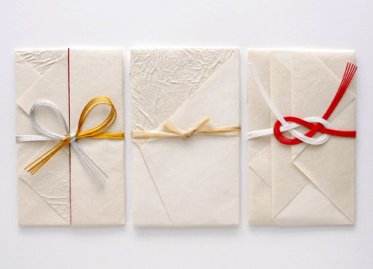
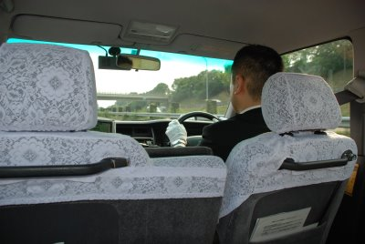
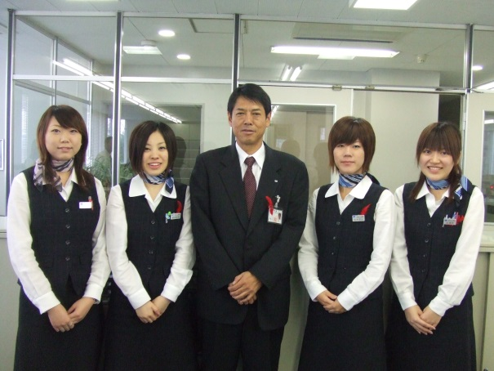
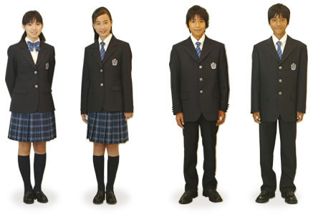
Appearances
Keeping up and maintaining appearances is very important

Slide 7
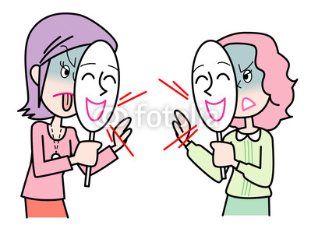
Honne (Private) vs. Tatemae (Public)
Honne is what someone really thinks or how they really feel (i.e. Their real opinion).
Tatemae is what someone is expected to think/do given the situation they are in, their position, or the work they do.

Slide 8
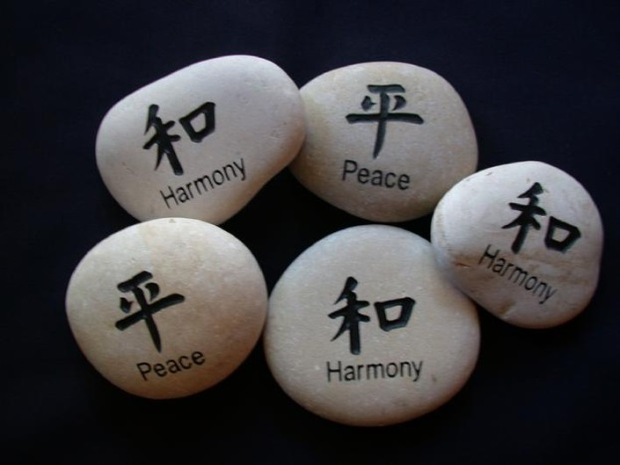
Harmony
Harmony is a key value in Japanese society and is the guiding philosophy for the Japanese in business settings and in society as a whole.
Japanese children are taught to act harmoniously and cooperatively with others from a young age.

Slide 9
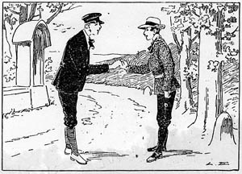
Basic Greetings
Good Morning!
おはようございます “Ohayou-gozaimasu”
Good Day! Hello!
こんにちは “Konnnichiwa”
Good Evening!
こんばんは “Konbanwa”
Good Night!
おやすみなさい “Oyasumi-nasai”

Slide 10
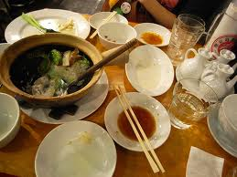
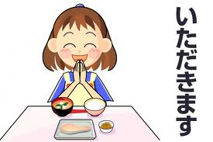
Eating
Before the meal
いただきます “Itadakimasu”
After the meal
ごちそうさまでした “Gochisou-sama-deshita
Please go ahead
おさきにどうぞ “Osaki ni dozo

Slide 11
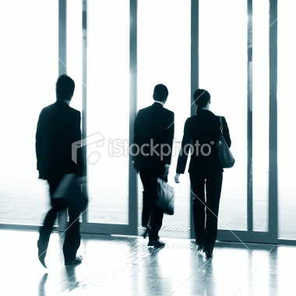
At Work
When arriving in the morning make sure to say おはようございます！ Ohayou-gozaimasu
After a task, when passing colleagues, etc.
おつかれさまです！ Otsukare-sama-desu
When Leaving
おさきにしつれいします！ Osakini-shitsurei-shimasu

Slide 12
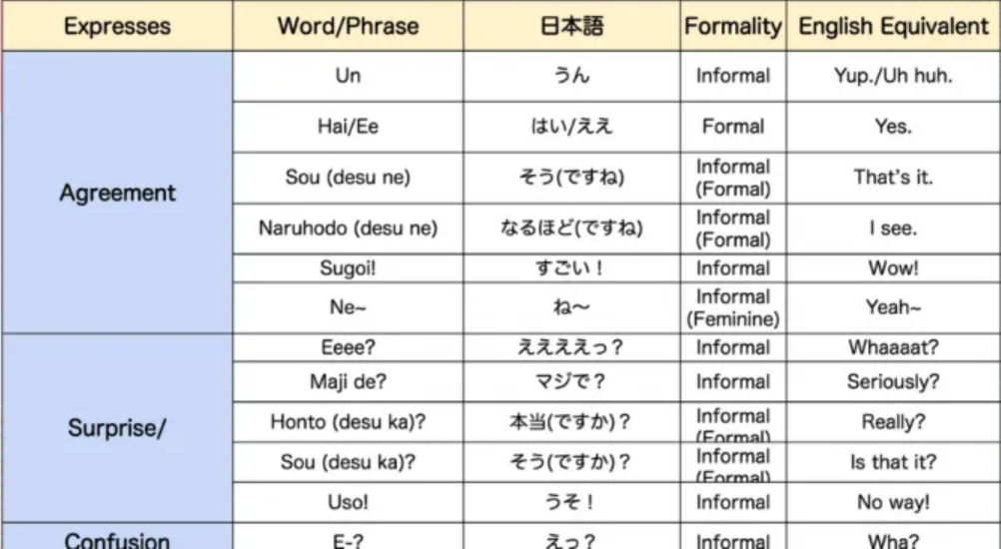
Aizuchi (相槌) – “Chiming In”

Slide 13
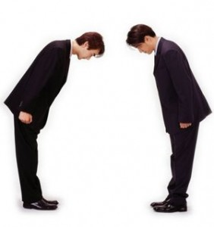
Bowing
Straight back
Don’t look at the person you’re bowing at
Women clasp hands in front
Men hands at sides
Longer and deeper is more formal

Slide 14
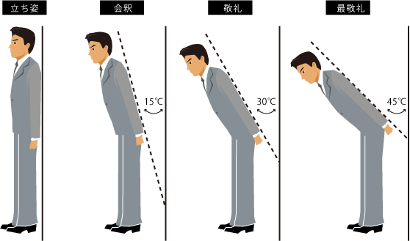
Different Bows

Slide 15
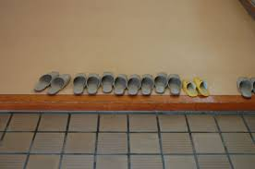
Shoes
Take off shoes when entering a house, or school
Special slippers to wear inside
Special slippers in bathrooms as well
When going onto Tatami take off your slippers

Slide 16
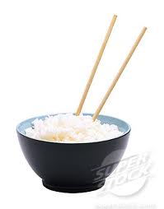
Food Do’s and Don’ts
Do
Slurp ramen, and noodles
Use opposite end of chopsticks when taking food from communal plate
Say “sumimasen” in a high pitched voice
Don’t
Stick chopsticks face up in rice
Pass food with chopsticks
Slurp western noodles (spaghetti)
Rub disposable chopsticks together
Eat/drink in public*

Slide 17
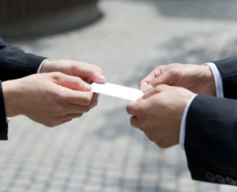
Business Cards
Make sure to receive it with both hands
Don’t stuff it into your pocket or write on it in front of the person

Slide 18
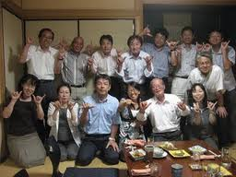
Drinking Parties
You will be directed to your seat
Wait for others to sit before you do
Wait for the “kanpai” or toast before you drink
Don’t pour drinks for yourself. DO pour drinks for other people. Chance to mingle
Non-alcoholic drinks will be available
Shime, banzai

Slide 19
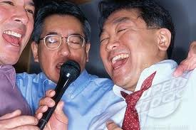
Afterparties – Niji-kai, Sanji-kai
Much more relaxed than the initial party
A great opportunity to talk to people

Slide 20
RULE #1 What happens at an Enkai stays at the Enkai

Slide 21
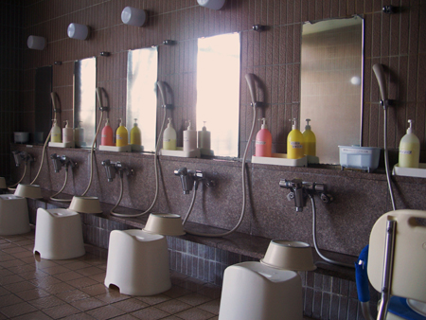
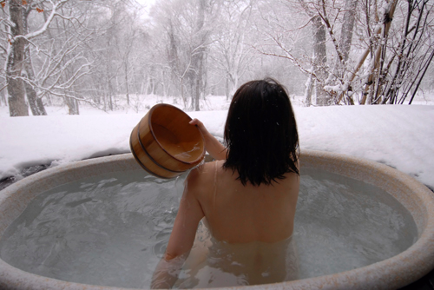
Bathing
Wash body before entering bath
There will be a shower area, sit down and wash yourself
Baths are for soaking, not bathing

Slide 22
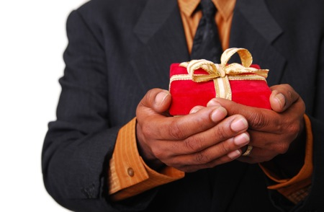
Gift Giving
When you go on a trip bring back a small thing for the people in your office
Bring a gift when visiting someone’s house
Good way to show gratitude/thoughtfulness

Slide 23
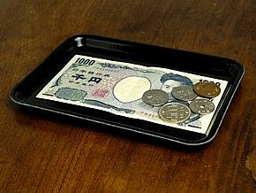
Visiting Stores/Payment
Most businesses give you a tray for payment
Don’t hand money directly to the person
If no tray hand it with both hands
Some store clerks will walk you out

Slide 24
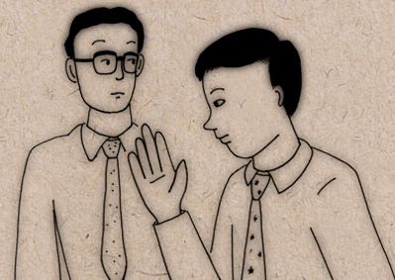
Cutting In front of People
Do a small cutting gesture and a light bow

Slide 25
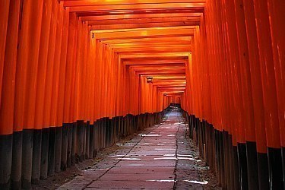
Visiting Shrines
Wash: Left hand, then right, then mouth*
Bow slightly.
Gently toss a coin into the box in front of you.
Ring the bell (if there is one) 2 or 3 times to signal to the gods that you have arrived.
Deeply bow twice (until you reach a 90 degree angle).
Clap twice, with your left hand slightly in front.
Pay your respects, remembering to thank the gods as well.
Deeply bow once.

Slide 26
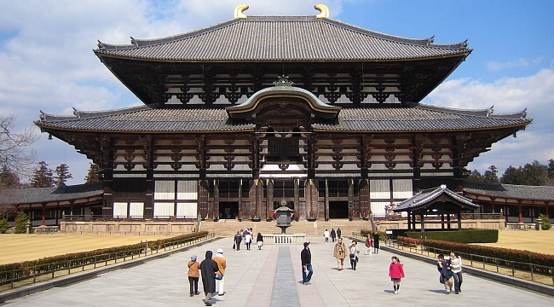
Visiting Temples
Bow slightly before entering, purify yourself.
Burn incense (usually provided at the temple); the scent of incense is food for the Buddha. Lighting your own incense stick off the burning sticks of others is a no-no, since it means taking on their sins.
Bow slightly.
Gently toss a coin into the box in front of you.
Ring the bell (if there is one) 2 or 3 times.
Bow slightly and pay your respects, putting your hands together but DO NOT CLAP. Don’t forget to thank the Buddha!
Bow slightly.

Slide 27
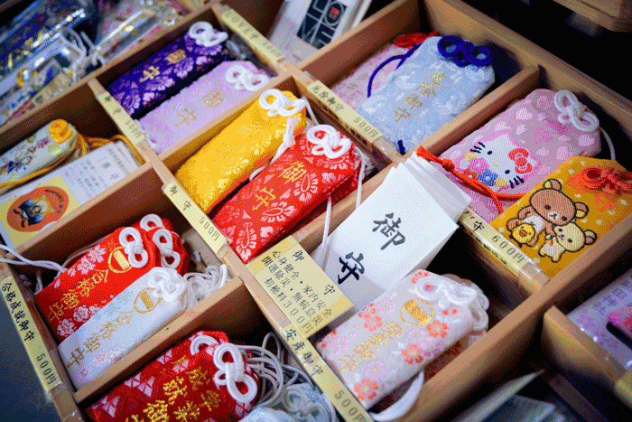
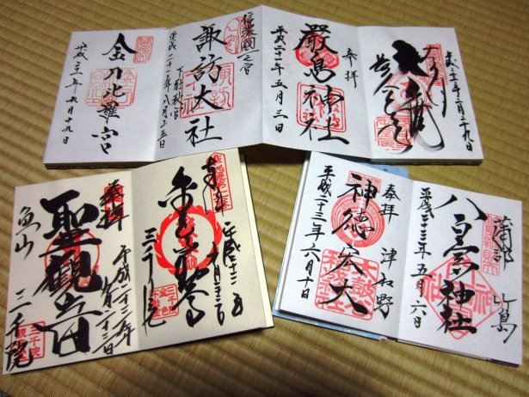
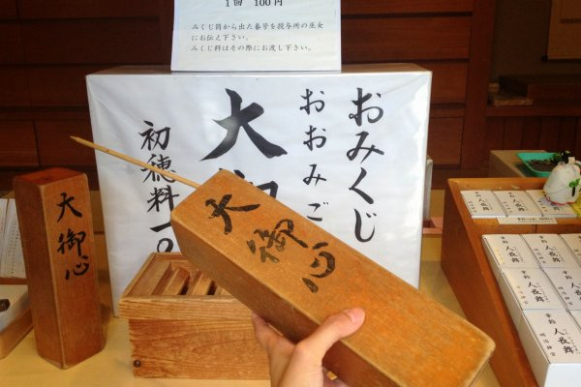
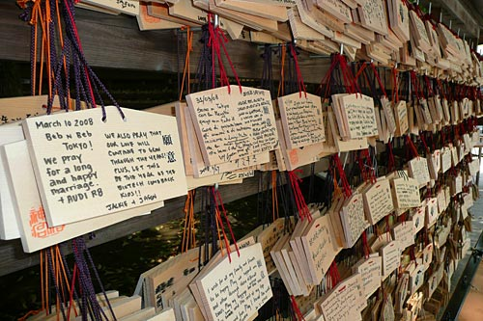
…After Paying Respects
Ema
Omamori
Omikuji
Goshuin(cho)

Slide 28
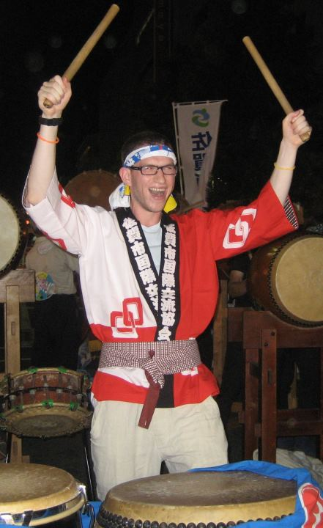
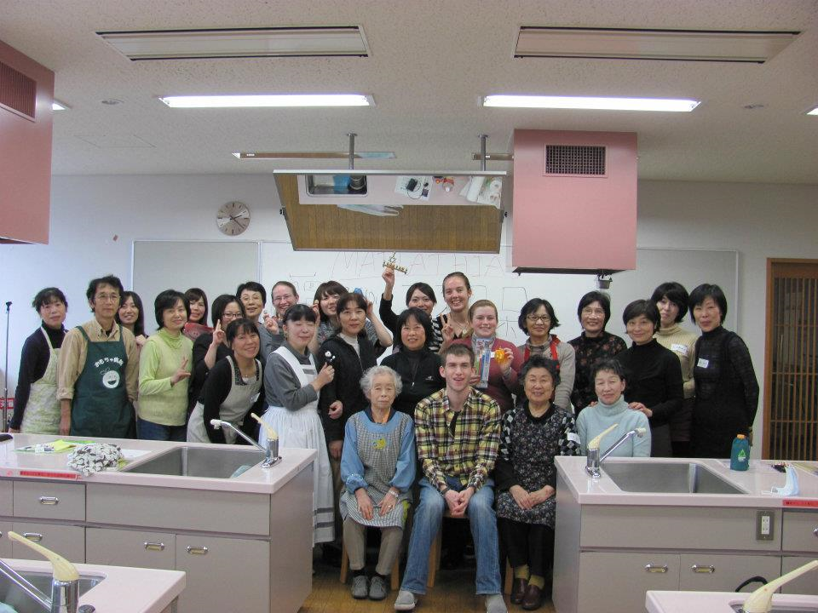
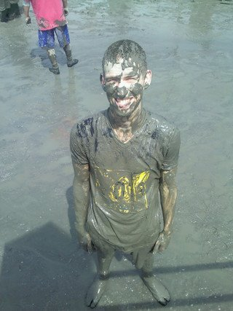
Always Be Open Minded!
Accept invitations
Try new foods
Say yes to things outside your comfort zone

Slide 29
Questions…

Slide 30
Extra Practice
おはようございます Ohayou-gozaimasu
Good Morning!
おつかれさまです Otsukare-sama-desu
Good work, “Tough thing we just did eh?”
おさきにしつれいします Osakini-shitsurei-shimasu
Excuse me for leaving first
いただきます Itadakimasu
I am receiving this food
ごちそうさまでした
Thank you for the meal / The food was delicious

