Slide 1
Money Management
For JETs
JET Pre-Departure Seminar 2022
Presented by Max Fisher

Slide 2
Overview
Before You Go
Expectations
Things to manage before you leave
Once in Japan
Getting bank account set up
Getting utilities set up
Car Expenses (if necessary)
Taxes and Pension
Planning for the Future
What you have to work with
Tips for saving money

Slide 3
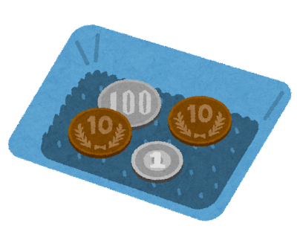
Before You Go - Setting Expectations
Japan is a cash based society!
You will need money to live on during your first month.
Housing (Security deposit, key money, rent, insurance)
Utilities
Car (for rural JETs)
Necessities (food, cleaning supplies, transportation, misc.)
Connect with your Predecessor or the other JETs.
Get a better idea of what to budget for your in area.
You may (but are not obligated to) buy furniture/vehicles from your predecessor.

Slide 4
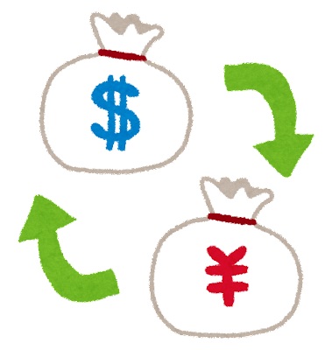
Before You Go - Getting Accounts in Order
Convert USD to Yen before you leave.
We recommend about $3,000.
You will not have time to convert money at orientation.
Minimize expenses here in the US.
Transferring money incurs fees.
Yen is currently very weak compared to the dollar.
Look into how you will get money home if needed.
Wise (formerly Transferwise)
GoRemit

Slide 5
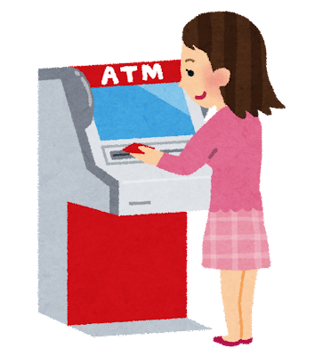
Once in Japan - First Days
Hanko
Setting up your bank account
Your supervisor will help you with this
Major banks are Sumitomo, Mizuho, and CitiBank
The Post Office
Banking hours
Closed on weekends, afternoons, and holidays.
ATMs open late, and can help with most functions.
Plan ahead!

Slide 6
Once in Japan - Phones and Internet
Wifi Options
You can arrange setup/ installation at your local shopping center, electronics store, or mall.
Pocket Wifi / Wifi Tower
Getting a Cellphone
Buying a cellphone from a major carrier can be tricky. Before purchasing anything, you will need proper identification: Hanko/Inkan, card, and bankbook.
Alternatively: Sakura Mobile (Can be set up now!)
The main cell phone providers are AU, Docomo, and Softbank.
Where do I pay my bills?
Town Office
Combini
Automatic Withdrawal

Slide 7
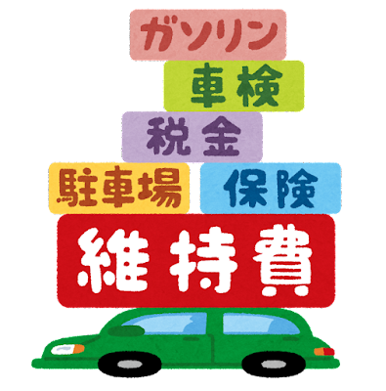
Once in Japan - Cars
Winter Tires ~$250
Shaken
Inspection every 2 years
Very Pricey ($800-$2,000)
Registration / Car Tax ~$200
Insurance ~$200
Parking ~?

Slide 8
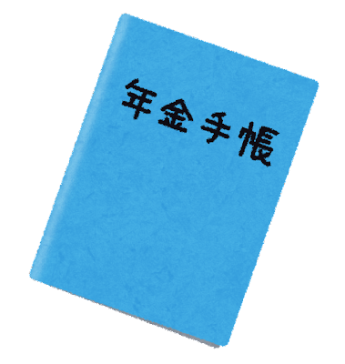
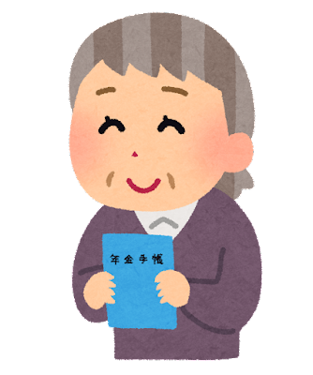
Once in Japan - Taxes and Pension Book
Taxes
All US JETs are required to file their local state and Federal taxes every year.
For instructions on how to file while abroad:
Read and review Publication 54 on the IRS website.
JET Program USA Tax Guide
Kumamoto Tax Guide (A great resource for everyone)
You will be able to file for an extension because you are living abroad.
Pension
Japanese pension payments are deducted from your salary.
You will receive a blue Pension Book, keeping track of these deductions. Do not lose this.
Ask your BOE how you can apply for a refund.

Slide 9
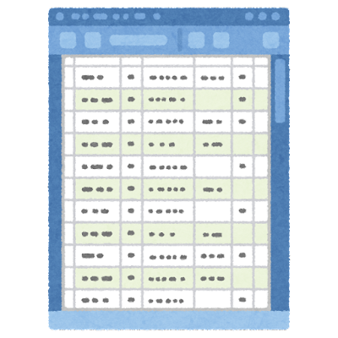
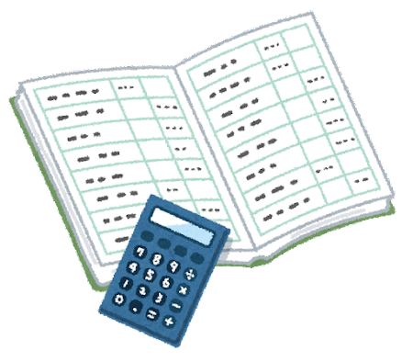
Saving for the Future - Salary and Planning
Salary by Year (before taxes)
Year 1 (2022): Approx. ¥3,360,000
Year 2: ¥3,600,000
Year 3: ¥3,900,000
Year 4/5: ¥3,960,000
Keep track of your spending
Write down what you are spending!
Find an app that works for you
Make an Excel spreadsheet

Slide 10
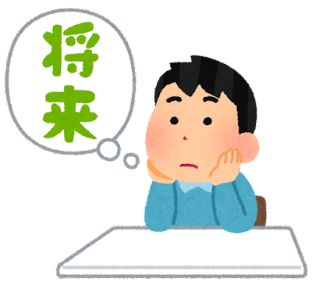
Saving for the Future - Money Saving Tips
Make use of sales and good deals
100 yen stores
Thrift stores
Late night grocery stores
Business loyalty cards
Avoid conbinis when you can
Set a goal for yourself
What do you want to come home with?
Consider investing
Don’t forget to live a little!

