Slide 1
ELEMENTARY, JUNIOR, AND SENIOR HIGH SCHOOL
JOB SKILLS WORKSHOP
BY MAXWELL FISHER (TOTTORI-KEN, 2018-2021) & ANDREW WILLIAMS (SHIZUOKA-KEN, 2012-2015)
Notes:
Ryan Intro

Slide 2
Overview And First Week
(Elementary School)
If you are a full time elementary school ALT
Get to know your surroundings; find your desk, school tour, etc
Very short introduction (simple for the kids)
Introduction lesson and short interview
If working from a base school (JHS)
Take a brief tour of all of your schools
Give brief self introductions to staff
Prepare a self introduction lesson (available tech wildly varies by school)

Slide 3
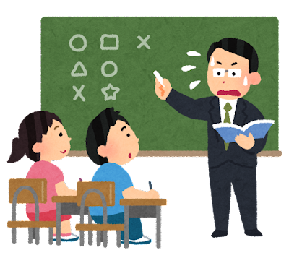
Overview And First Week
(Junior High School)
Get to know your surroundings—your desk, school tour, know your attire, transportation to and from school, etc.
At least three different speeches—teacher’s room, whole school, welcome enkai (if covid restrictions allow)
Start preparing self-introduction lesson:
You will likely use powerpoint, bring lots of pictures of family, friends, local landmarks, etc.
Be prepared for questions!

Slide 4
Overview And First Week (High School)
Get to know your surroundings—where you’ll sit in the teacher’s room, where the office is, where to sign in, lunch, etc.
At least three different speeches—teacher’s room, whole school, welcome enkai
Start preparing for your self-introduction lesson
Find students!

Slide 5
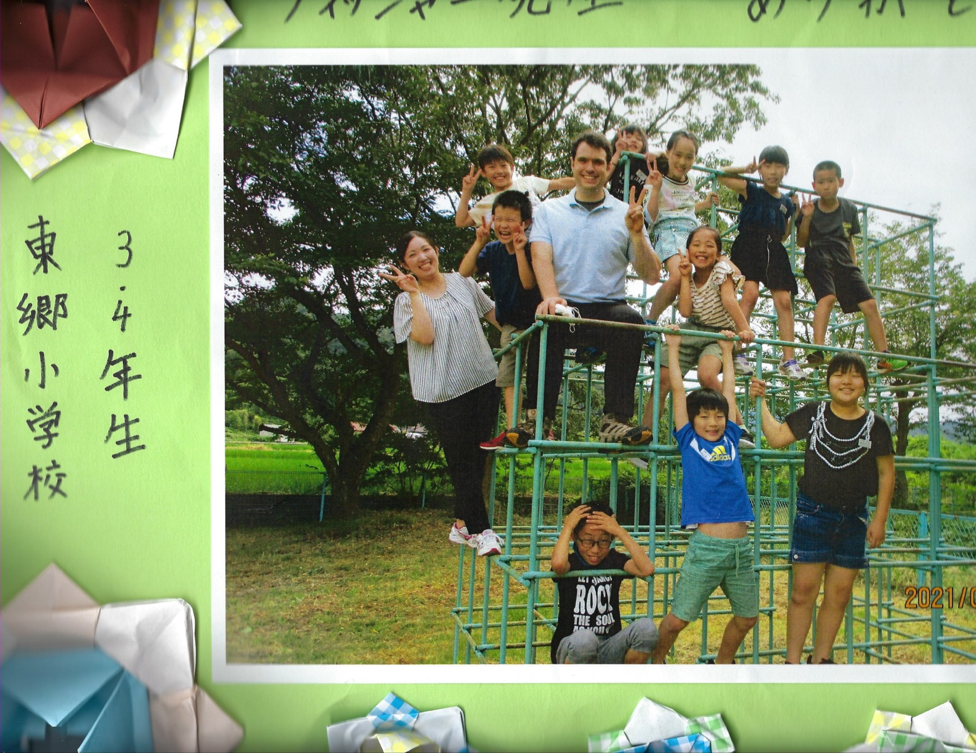
Life In Elementary School
1st to 6th grade
Lots of vocabulary, low grammar
Grammar starts in 5th grade
Lots of games and fun activities: bingo, fruits basket, sing along activities
Students will want to play games with you at lunchtime
School, class sizes, available technology, and english fluency vary from school to school

Slide 6
Life In Junior High School
7th to 9th grade
Focus on all skills: reading, writing, speaking, listening
Your involvement in class depends on JTE (Japanese teacher of English, aka your co-teacher)
Arrive and Roll: JTE makes the lesson plan, will ask for your help and input
ALT’s daily activity: JTE will ask you to prepare and run certain activities
Plan the Class: You write the lesson plan and act as main teacher
School events: Sports Day, Cultural Festival, graduation, and Entrance Ceremony

Slide 7
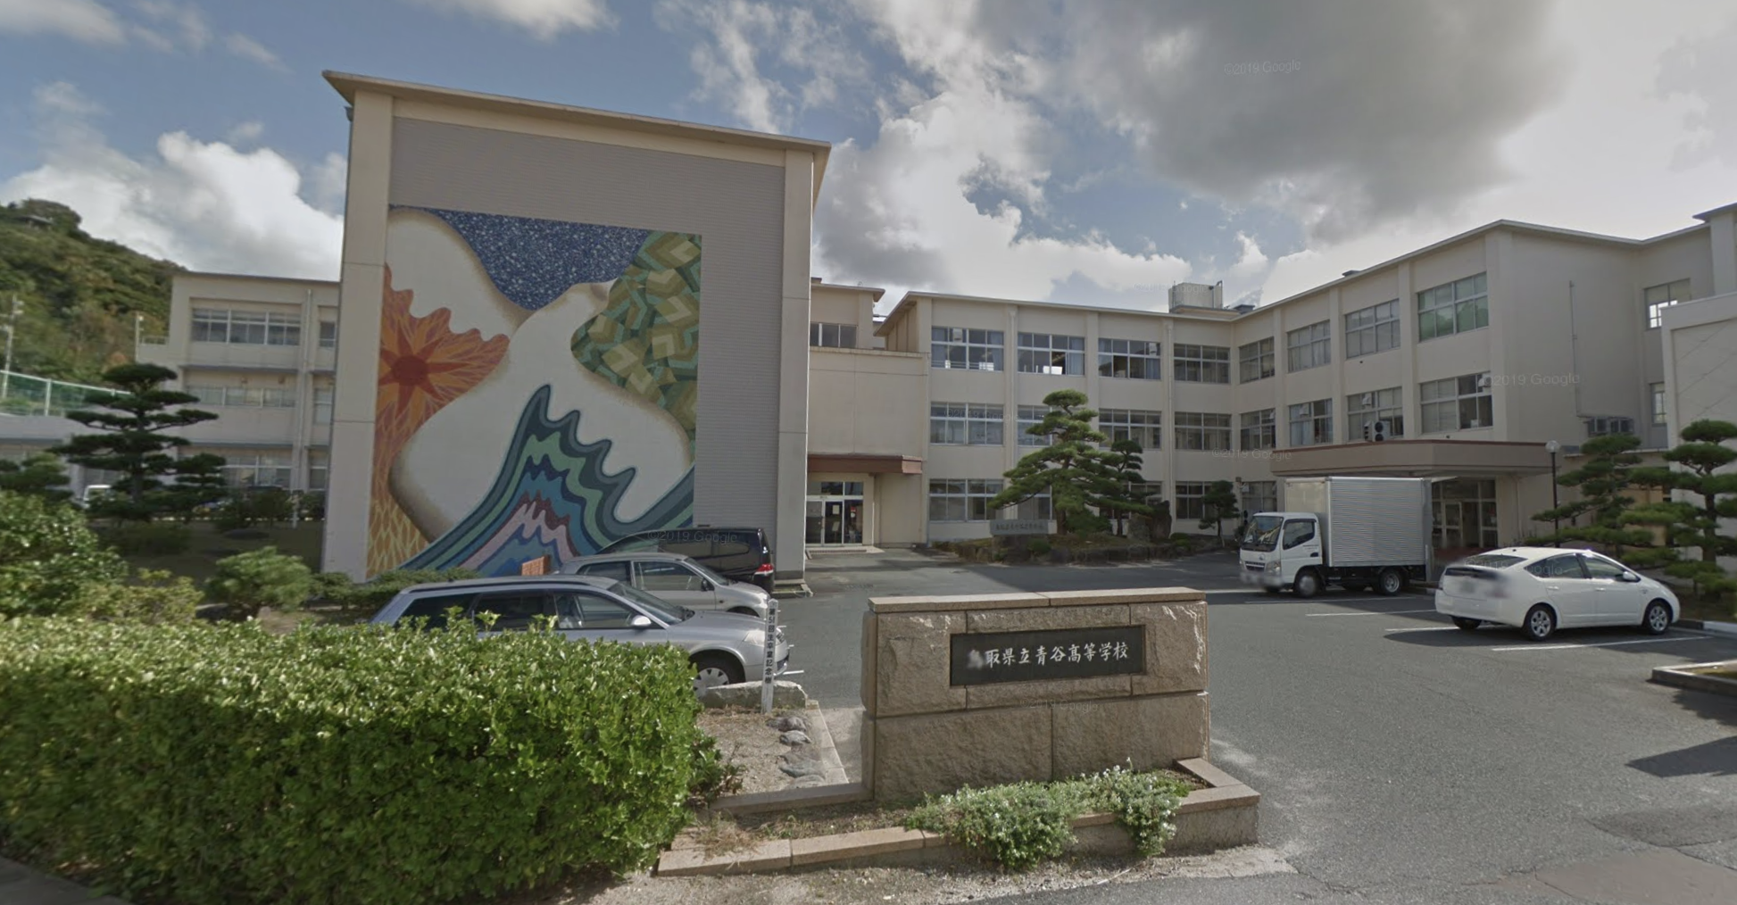
Life in Senior High School
As you know, every situation is different—get to know your senior high school(s), classes, and students
Know your role with each Japanese teacher of english (jte)
Know what your school(s) expects of you (high or low academics?)
Be prepared for schedule changes: open house, assembly, exams, etc.

Slide 8
PRO TIP Elementary School: Energy Conservation
When kids will want to play with you during recess, what do you do if you don’t have the energy?
Play soccer, be the goalkeeper
Distribute the ball during basketball or dodgeball
You don’t have to run during onigoko
Everyone gets one lift, one
Suggest reading a book instead!

Slide 9
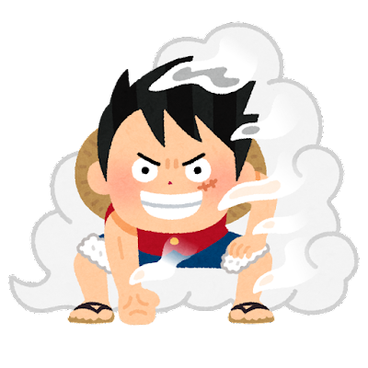
PRO TIP Junior High: What’s Popular?
It helps to know what kids are into, incorporate them into your lessons
Popular things you might want to know (and have an opinion) about
Sports: baseball, soccer (esp European clubs)
Video games: Fortnite, Smash Brothers
K-pop and J-pop: BTS, Twice
Anime: One Piece, Demon Slayer [Kimetsu no Yaiba]
Club activities: vary by school

Slide 10
PRO TIP High School: Engagement
In general, getting students to participate and speak in class is a lot harder than it is in America, so you want to find ways to engage your students as much as possible.
For example, use a cute background like this one if you’re using slides in class! This is so different from what students experience in a lot of their other classes that it will immediately pull them in. They’re NOT too old for it.
Notes:
I created a stamp sheet where students would be rewarded for turning in assignments, attempting and participating, etc. Once students filled things out, I was allowed to give them individually wrapped chocolate from Hawaii
The stamp card also served as a duo purposed and turned into the students’ name card

Slide 11
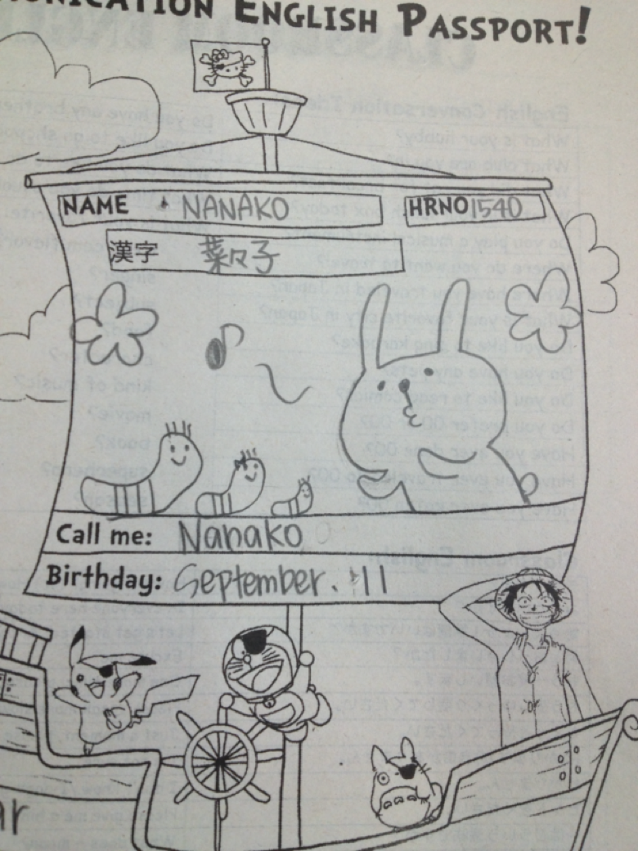
PRO TIP HIGH SCHOOL: REWARDS
If you can use a rewards/incentive system, it can greatly increase your students’ participation and love of your class.
I used something called Passports.
Notes:
I created a stamp sheet where students would be rewarded for turning in assignments, attempting and participating, etc. Once students filled things out, I was allowed to give them individually wrapped chocolate from Hawaii
The stamp card also served as a duo purposed and turned into the students’ name card

Slide 12
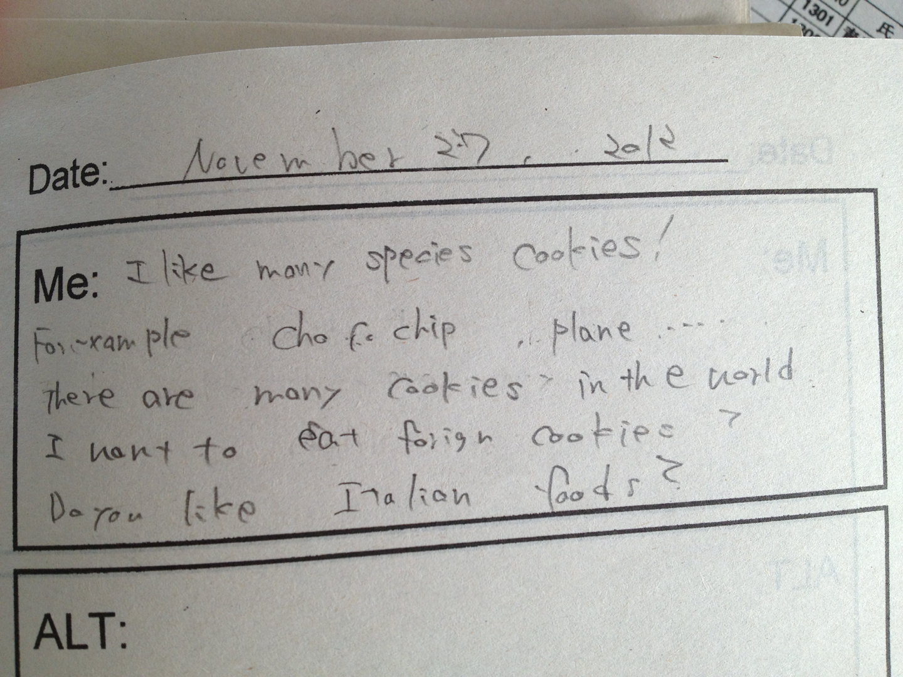
PRO TIP HIGH SCHOOL: REWARDS
Passports have a dual purpose of being a rewards system and also getting to know your students by being a chance to write to each other every class.
This is great for building relationships AND for designing fun lessons based on your students’ interest!
Notes:
I created a stamp sheet where students would be rewarded for turning in assignments, attempting and participating, etc. Once students filled things out, I was allowed to give them individually wrapped chocolate from Hawaii
The stamp card also served as a duo purposed and turned into the students’ name card

Slide 13
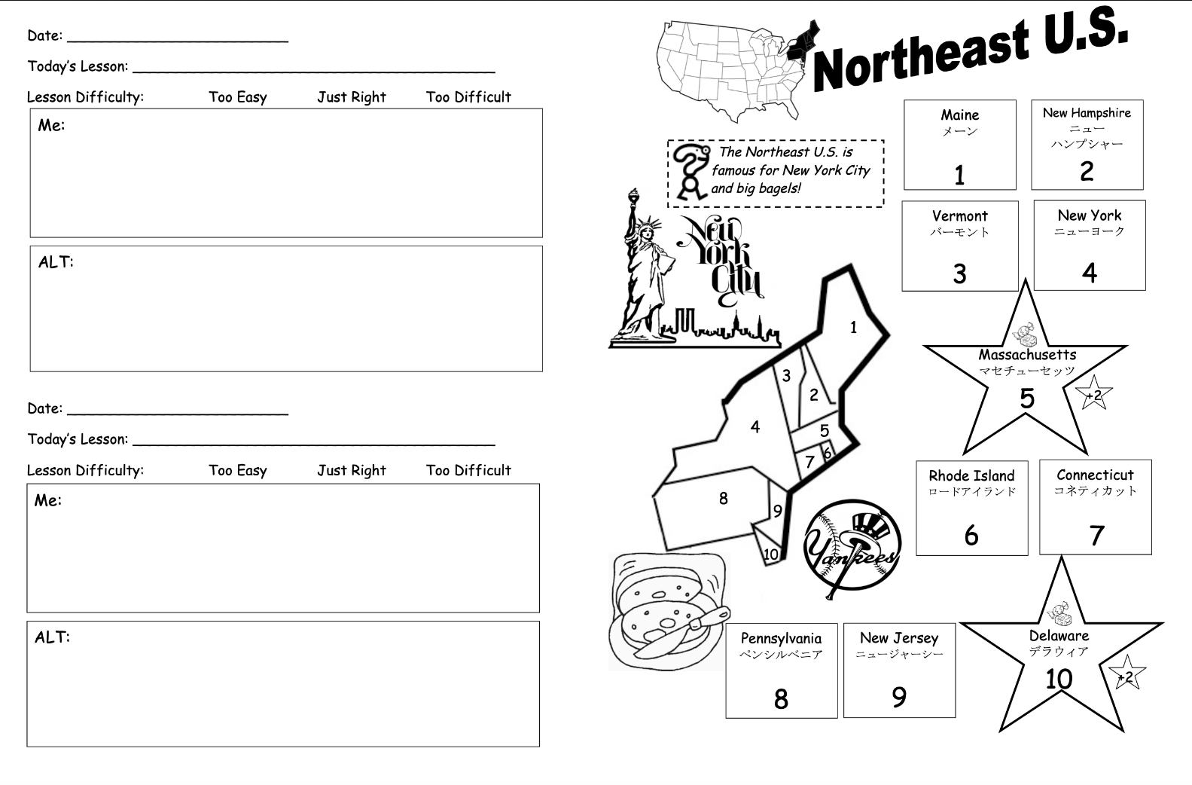
Want this? Download at:
https://tinyurl.com/5n75d9v5

Slide 14
Activities That Worked Well
ONE MINUTE CONVERSATION
Students are generally afraid to make mistakes, and hesitate to speak as a result.
To get them talking, try using a simple question like:
What color do you like?
What did you do on saturday?
If you had 1 million yen, what would you buy?
Demonstrate with your JTE.
Make it a game: how many words can you say in one minute? keep track over time and student’s confidence will grow as they see their improvement!

Slide 15
ACTIVITIES THAT WORKED WELL
Kahoot or Blooket
(!) Only available if students have their own devices
Application to make quiz games
Easy to use, fun for students, and provides feedback based on student responses

Slide 16
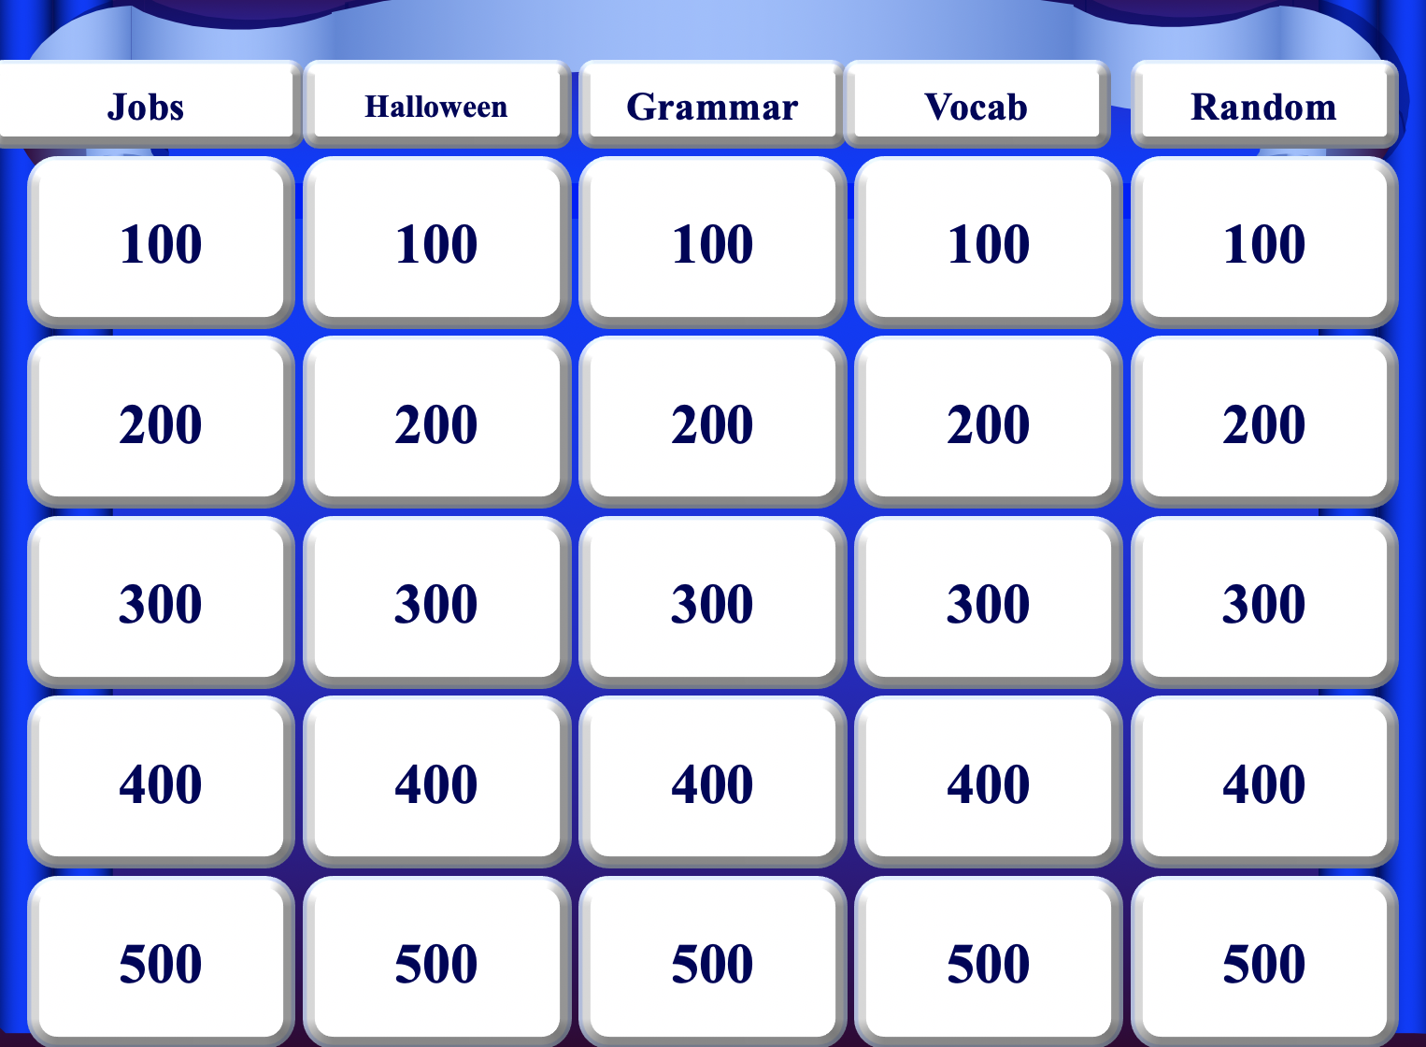
ACTIVITIES THAT WORKED WELL
Modify the Textbook Lessons with Games
Find as many creative ways as possible to add games to lessons if your situation allows it. You will find that many Japanese English textbooks tend to be very dry. If you can pick one main point of a lesson and create a game around it, the students will enjoy it and so will you!
Notes:
1. General English Communication—Card games, Interactive PowerPoints like Jeopardy or Super Mario Brothers Game,

Slide 17
ACTIVITIES THAT WORKED WELL
Music Videos as a Daily Warm-Up!
Find English-speaking artists your students like, and you can do countless activities. For example:
Show a lyric video and have students count how many times a specific word appears. (You can even differentiate this by using words that come up more or less frequently and allowing students to choose based on their level.)
Cut out song lyrics in strips and have students listen to the song and put them in order.
Have them fill in the blank with lyrics.
Notes:
1. General English Communication—Card games, Interactive PowerPoints like Jeopardy or Super Mario Brothers Game,

Slide 18
Share Your Culture!
Your role is cultural ambassador as well as ALT, so incorporating your culture into lessons is a great idea.
When possible, you can teach about holidays or traditions you celebrate, and if you can do hands-on activities like dying Easter Eggs or things like that, they’ll be even more engaged and interested!

Slide 19
QUESTIONS, COMMENTS, CONCERNS?
Maxwell: mpfisher21@gmail.com
Andrew: andrew.williams0421@gmail.com

