Slide 1
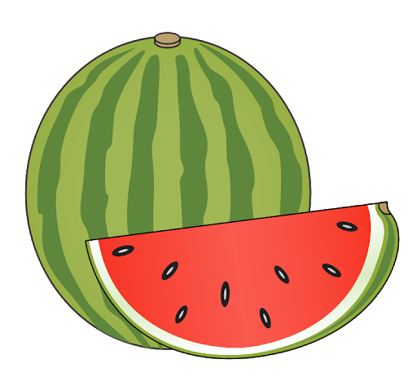
Dietary Restrictions
(Allergies, Religious Restrictions, and Being a Vegan/Vegetarian)

Slide 2
Allergies

Slide 3
The Seven Allergens
These allergens are always labeled:
Buckwheat (蕎麦/そば)
Crab (蟹/かに)
Egg (卵/たまご)
Milk (牛乳/ぎゅうにゅう)
Peanut (落花生/ピーナツ)
Shrimp (海老/えび)
Wheat (小麦/こむぎ)

Slide 4
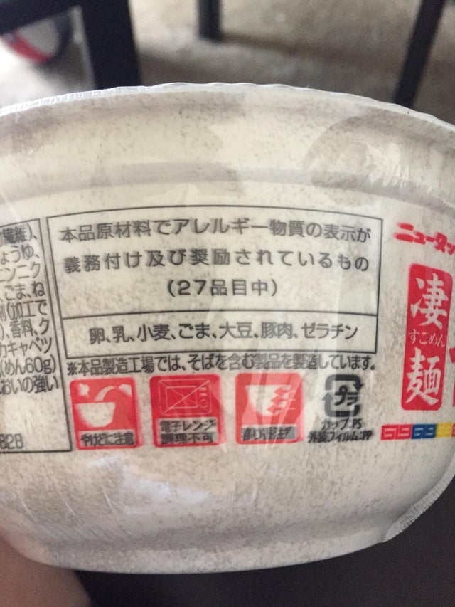
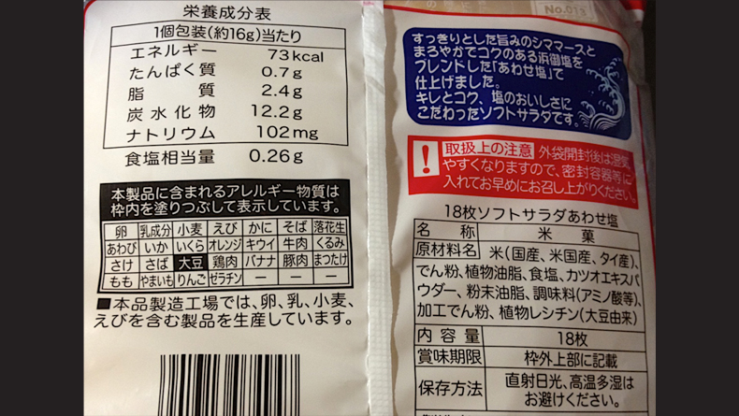
Common Allergen Labels

Slide 5
All the Allergens on the Label
These are the allergens in the box in order (starting from top left):
卵 – egg 乳成分 - dairy 小麦 – wheat えび – shrimp かに – crab そば – soba 落花生 – peanuts
あわび – abalone いか – squid いくら – salmon roe オレンジ – orange キウイ – kiwi 牛肉 – beef くるみ - walnuts
さけ – salmon さば – mackerel 大豆 – soy 鶏肉 – chicken バナナ – banana 豚肉 – pork まつたけ - mushrooms
もも – peach やまいも – yam りんご – apple ゼラチン - gelatin

Slide 6
If You’re at a Restaurant:
Ask for the allergen list before you order (you can sometimes find it online).
Small restaurants may not be aware of all allergens or dietary restrictions. Don’t be afraid to ask about ingredients if you’re not sure!
Restaurants often will not or cannot substitute ingredients, although you never know until you ask.

Slide 7
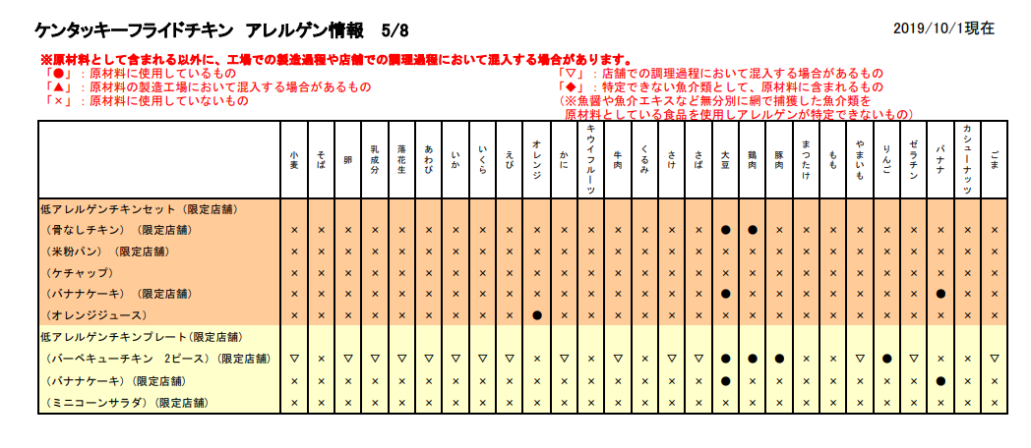
The Restaurant Allergen List
Circle – contains the ingredient
Triangle – might contain the ingredient/possible cross contamination
X – does not contain the ingredient

Slide 8
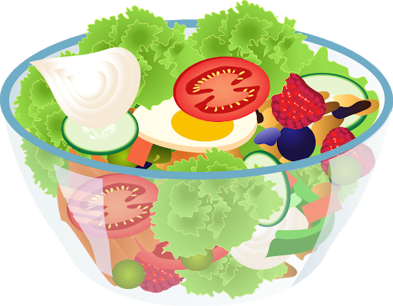
Religious Restrictions and Being a Vegetarian/Vegan

Slide 9
Pop quiz! Which of these foods are vegetarian?

Slide 10
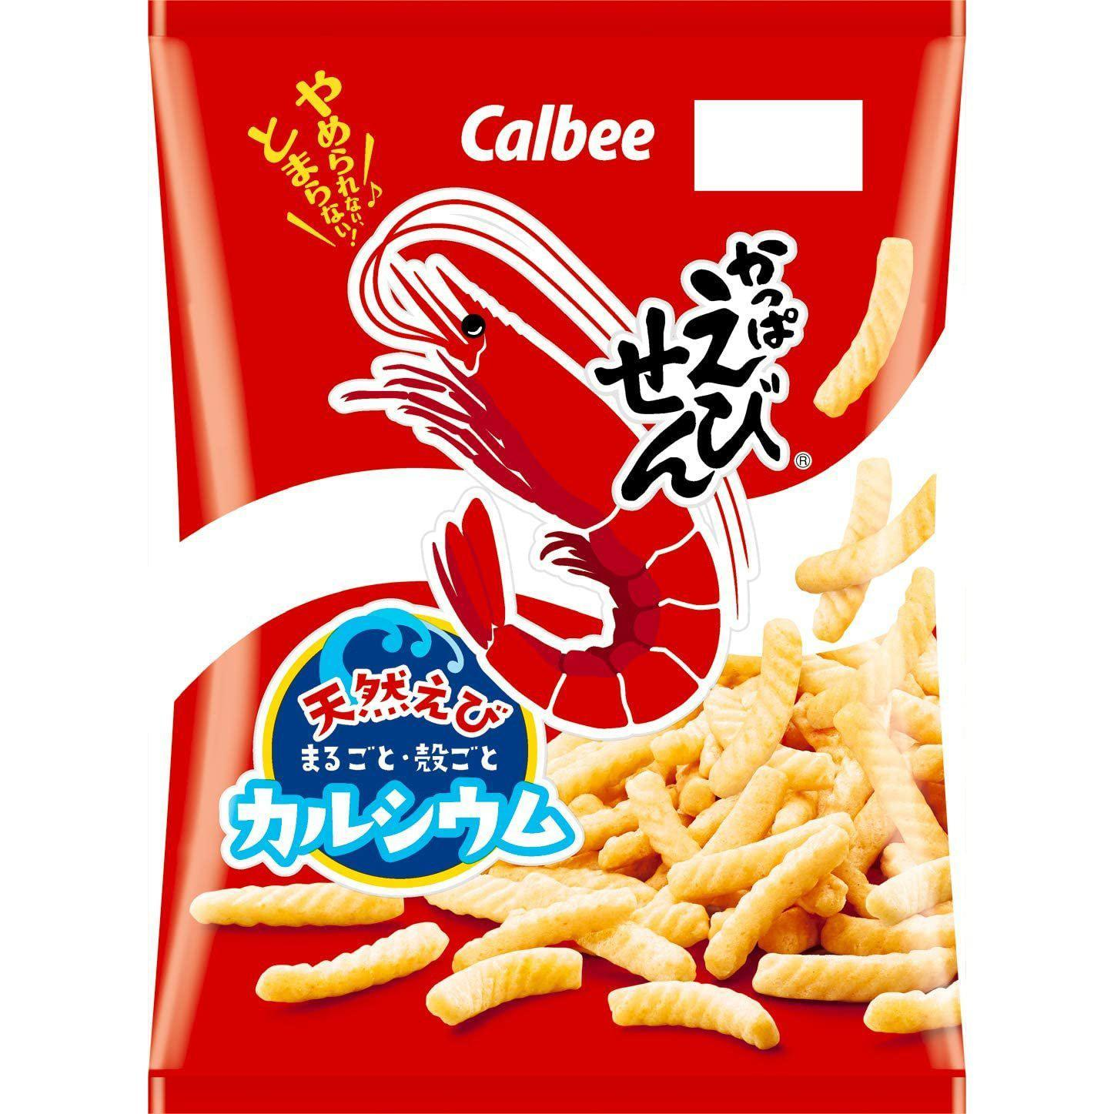
Chips – shrimp flavor

Slide 11
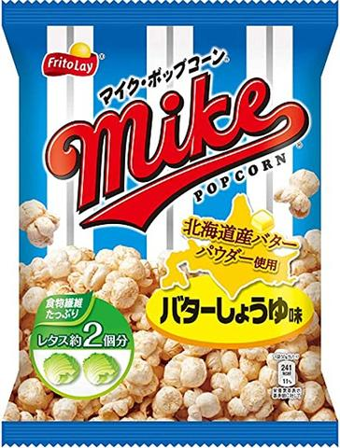
Popcorn – butter soy sauce flavor

Slide 12
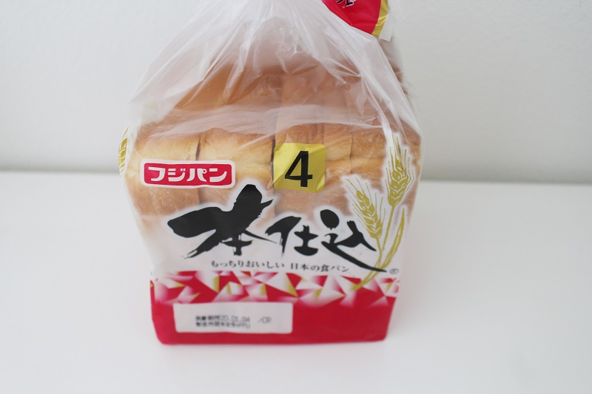
Sandwich bread

Slide 13
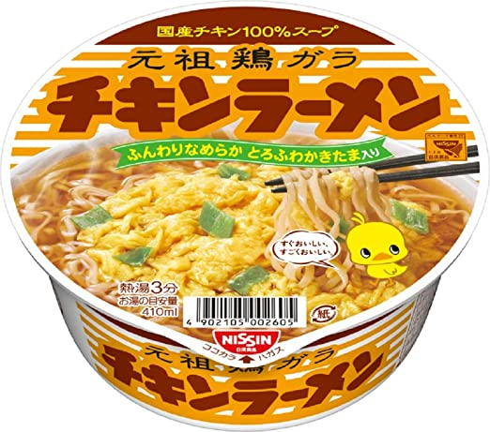
Ramen – chicken flavor

Slide 14
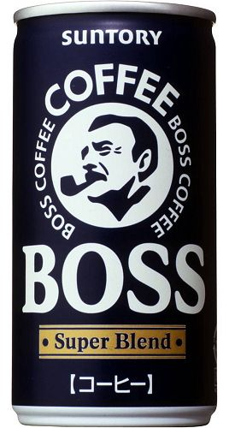
Black coffee

Slide 15
None of them – always read the label!

Slide 16
Food to Look Out For (see ingredients list)
Bread products such as sandwich bread, cookies, and cakes (shortening)
Curry, including vegetarian curry (lard)
Packaged drinks and soups (emulsifiers)
Puddings and yogurts (gelatin)
Gummies (gelatin)
Ice cream (alcohol)

Slide 17
Helpful Apps for Reading Labels
Google translate
Japanese – English dictionaries (my recommendation is “imiwa?”)
Kanji dictionaries (my recommendation for iphone is “Jishop”)
Payke
Halal Japan

Slide 18
Helpful Websites
Is it Vegan? (Japan)
https://isitveganjapan.com/food-on-the-go/507-2/
Halal Japan facebook page
https://www.facebook.com/japanhalal/photos/?tab=album&ref=page_internal

Slide 19
Careful with the Halal Japan facebook page. The original page was hacked, so if you look it up, you’ll find two pages. One has information about the official app, which I highly recommend. The other has been taken over by short videos, but all the old photo albums with halal vs. non-halal food categorized into easy lists. They’re both useful, but please don’t interact with the hacked one.

Slide 20
There is a lot of food you can eat in Japan, even with dietary restrictions. Focus on what you can have, and enjoy Japanese food! Thank you for listening.

